Slide 1

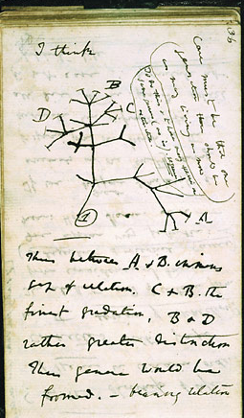
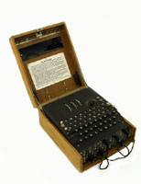
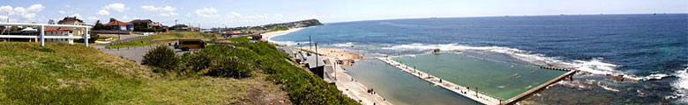

PSLQ CARMA-NT Seminar
(Nov 25) based on
Second Annual Rubinov
Memorial Lecture
November 9th 2009
The Computer as Crucible:
The End of Theory?
Charles Darwin’s notes
Alan Turing’s Enigma
Jonathan Borwein, FRSC www.carma.newcastle.edu.au/~jb616
Laureate Professor University of Newcastle, NSW
Director, Centre for Computer Assisted Research Mathematics and Applications CARMA
Revised 24-11-09

Slide 2
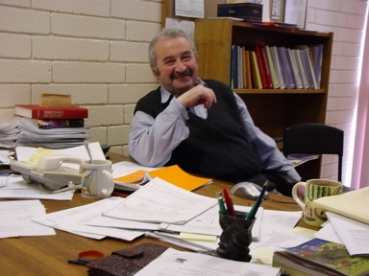
Dedicated to the Memory of our Friend and Colleague
Alex Rubinov (1940-2006)
Kind,
Scholarly,
Energetic,
Enthusiastic,
and a true
Gentleman
1980 I first met Alex in print (from Siberia)
- V. L. Makarov and A. M. Rubinov, Mathematical theory of economic dynamics and equilibria, 1973 (1977 English).
1997 I first met Alex in person (in Newcastle)
Notes:
Scan Rubinov page. Check 1995

Slide 3
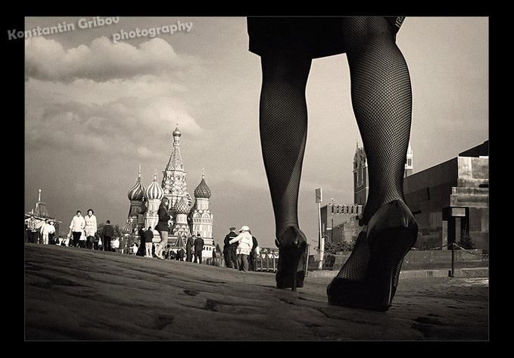
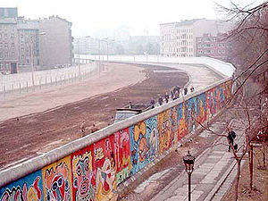
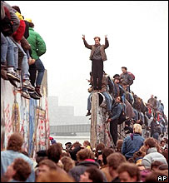
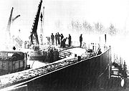
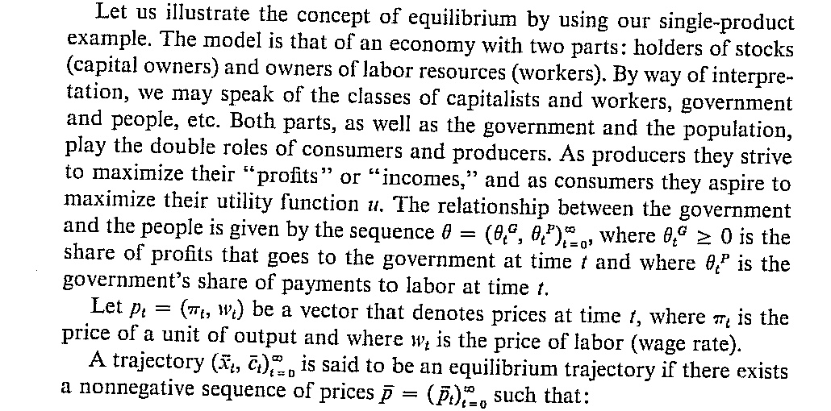
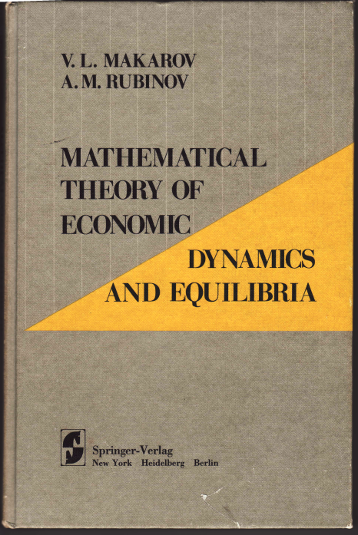
How the World has Changed since 1977
1961
1986
From preface of my copy of the English edition
09/11/1989

Slide 4
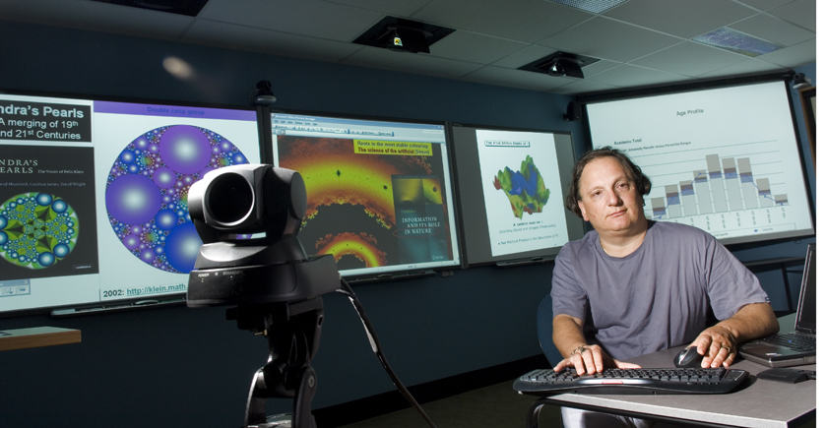

ABSTRACT
Jonathan M. Borwein
Director
Newcastle Centre for
Computer Assisted Research Mathematics and its Applications (CARMA)
As Keith Devlin and I wrote in our 2008 AK Peters book `` The Computer as Crucible”
  “Experimental mathematics is the use of a computer to run computations—sometimes no more than trial-and-error tests—to look for patterns, to identify particular numbers and sequences, to gather evidence in support of specific mathematical assertions, assertions that may themselves arise by computational means, including search. Like contemporary chemists—and before them the alchemists of old—who mix various substances together in a crucible and heat them to a high temperature to see what would happen, today’s experimental mathematician puts a hopefully potent mix of numbers, formulas, and algorithms into a computer in the hope that something of interest emerges.

Slide 5
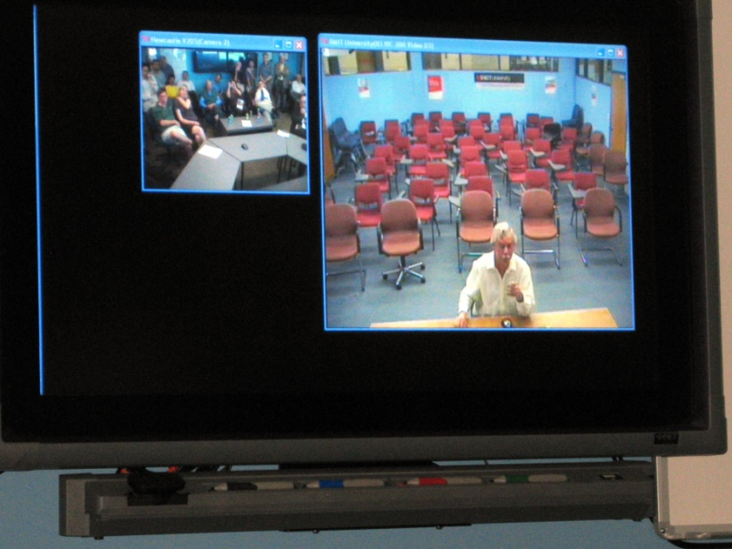
ABSTRACT
Jonathan M. Borwein
Director
Newcastle Centre for
Computer Assisted Research Mathematics and its Applications (CARMA)
  “Experimental mathematics is fairly new. It is a way of doing mathematics that has been made possible by fast, powerful, easy-to-use computers, by networks, and by databases. The use of computers in mathematics for its own sake is a recent phenomenon — much more recent than the computer itself, in fact. (This surprises some outsiders, who assume, incorrectly, that mathematicians led the computer revolution. To be sure, mathematicians invented computers, but then they left it to others to develop them, with very few mathematicians actually using them until relatively recently.)”
I shall describe—with accessible examples—how experimental mathematics works, what it has to offer, and what challenges it presents.
"The object of mathematical rigor is to sanction and legitimize the conquests of intuition, and there was never any other object for it." – Jacques Hadamard

Slide 6
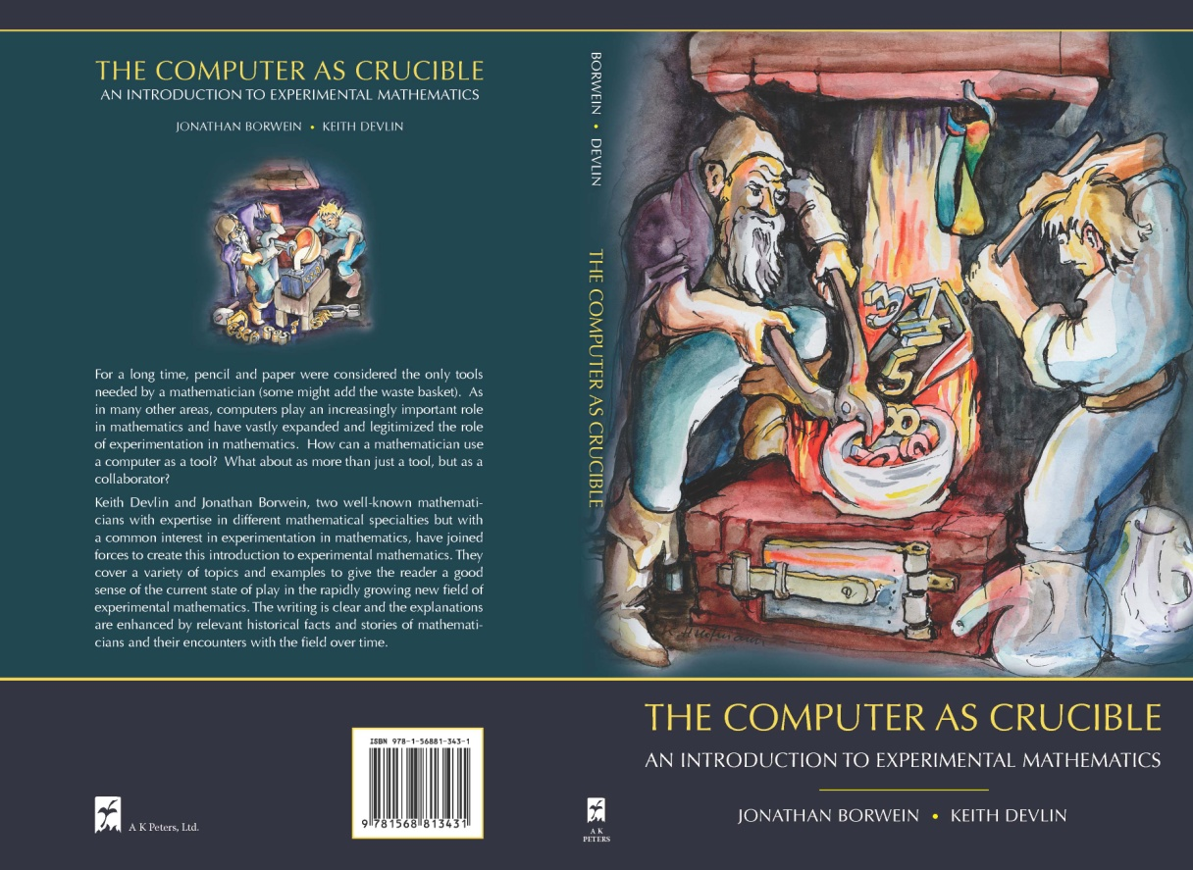

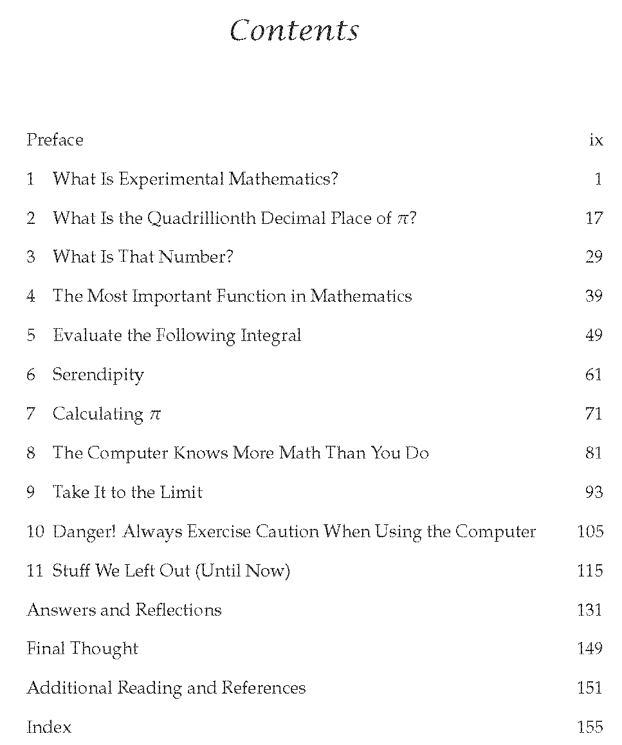
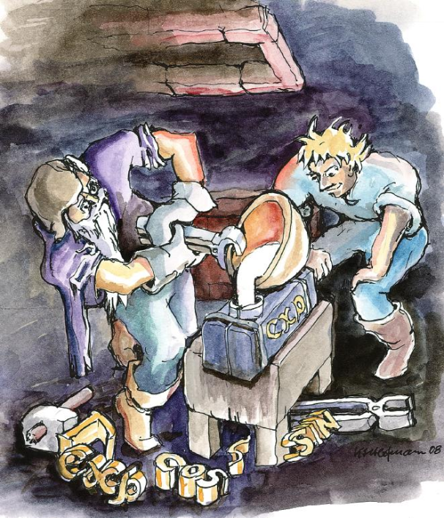
“The Crucible” An advert

Slide 7
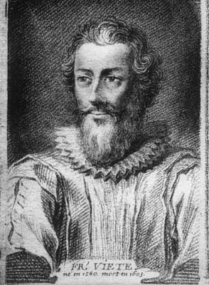

Francois Vieta (1540-1603): Philosophy Matters
Arithmetic is absolutely as much science as geometry [is]. Rational magnitudes are conveniently designated by numbers and irrational [magnitudes by irrational [numbers]. If someone measures magnitudes with numbers and by his calculation get them different from what they really are, it is not the reckoning's fault but the reckoner's.
Rather, says Proclus, ARITHMETIC IS MORE EXACT THAN GEOMETRY. To an accurate calculator, if the diameter is set to one unit, the circumference of the inscribed dodecagon will be the side of the binomial [i.e. square root of the difference Whoever declares any other result, will be mistaken, either the geometer in his measurements or the calculator in his numbers.
The inventor of `x’ and ‘y’ he did not believe in negative numbers
Veita as translated in the third edition of my 1997 Sourcebook on Pi

Slide 8
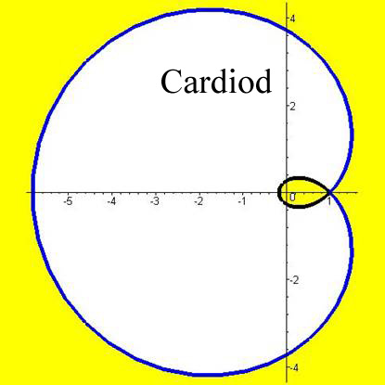
OUTLINE
with background and history of my own activities
Part I. What is Experimental Mathematics?
  Discovery and Digital Assistance
Part II. ISC and Colour Calculator
  Identify and OEIS in action
Part III. Integer Relations
  What they are and what they do
    Elementary and advanced examples
    Algorithmic details
A Scatter Plot Discovery
“The new availability of huge amounts of data, along with the statistical tools to crunch these numbers, offers a whole new way of understanding the world. Correlation supersedes causation, and science can advance even without coherent models, unified theories, or really any mechanistic explanation at all. There's no reason to cling to our old ways. It's time to ask: What can science learn from Google?” - Wired, 2008

Slide 9
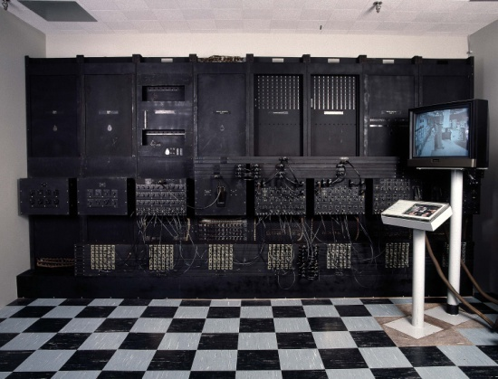
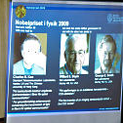

I. DIGITALLY ASSISTED DISCOVERY
Relies on Information and Communication Technology (ICT) not just IT
1946 ENIAC (‘first’ digital computer (5K/sec))
1966 Fiber optics
  Charles Cao (2009 physics Nobel),
  Hong Kong Uni VC
  1969 CCDevice (09 physics Nobel) Boyle (Canada) and Smith
and the ‘3Ms’ workspaces (and open source counterparts)
1980 Maple
  I have a Maple 1.2 manual
1984 MATLAB
1988 Mathematica
"What the wheel did for transport, the optical fiber did for telecommunications,"
- Richard Epworth, 1960s co-worker of Kao at the Standard Telecommunications Laboratories in Harlow, UK
Notes:
Rubinov page

Slide 10
WHAT is a DISCOVERY?
“discovering a truth has three components. First, there is the independence requirement, which is just that one comes to believe the proposition concerned by one’s own lights, without reading it or being told. Secondly, there is the requirement that one comes to believe it in a reliable way. Finally, there is the requirement that one’s coming to believe it involves no violation of one’s epistemic state. …
In short , discovering a truth is coming to believe it in an independent, reliable, and rational way.”
Marcus Giaquinto, Visual Thinking in Mathematics. An Epistemological Study, p. 50, OUP 2007
“All truths are easy to understand once they are discovered; the point is to discover them.” – Galileo Galilei

Slide 11
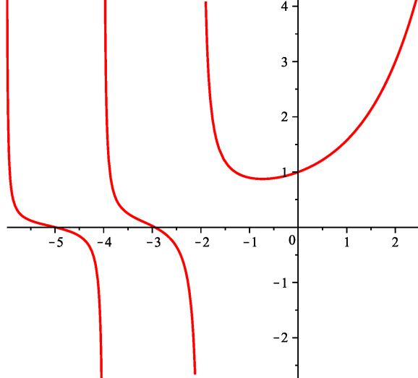
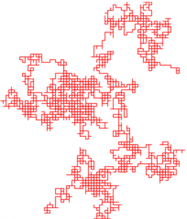
A Very Recent Discovery
(“independent, reliable and rational”)
W₃(s)
counts abelian squares

Slide 12
WHAT is a PROOF?
“PROOF, n. a sequence of statements, each of which is either validly derived from those preceding it or is an axiom or assumption, and the final member of which, the conclusion , is the statement of which the truth is thereby established. A direct proof proceeds linearly from premises to conclusion; an indirect proof (also called reductio ad absurdum) assumes the falsehood of the desired conclusion and shows that to be impossible. See also induction, deduction, valid.”
Borowski & JB, Collins Dictionary of Mathematics
INDUCTION, n. 3. ( Logic) a process of reasoning in which a general conclusion is drawn from a set of particular premises, often drawn from experience or from experimental evidence. The conclusion goes beyond the information contained in the premises and does not follow necessarily from them. Thus an inductive argument may be highly probable yet lead to a false conclusion; for example, large numbers of sightings at widely varying times and places provide very strong grounds for the falsehood that all swans are white.
“No. I have been teaching it all my life, and I do not want to have my ideas upset.” - Isaac Todhunter (1820-1884) recording Maxwell’s response when asked whether he would like to see an experimental demonstration of conical refraction.

Slide 13
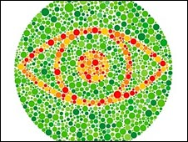
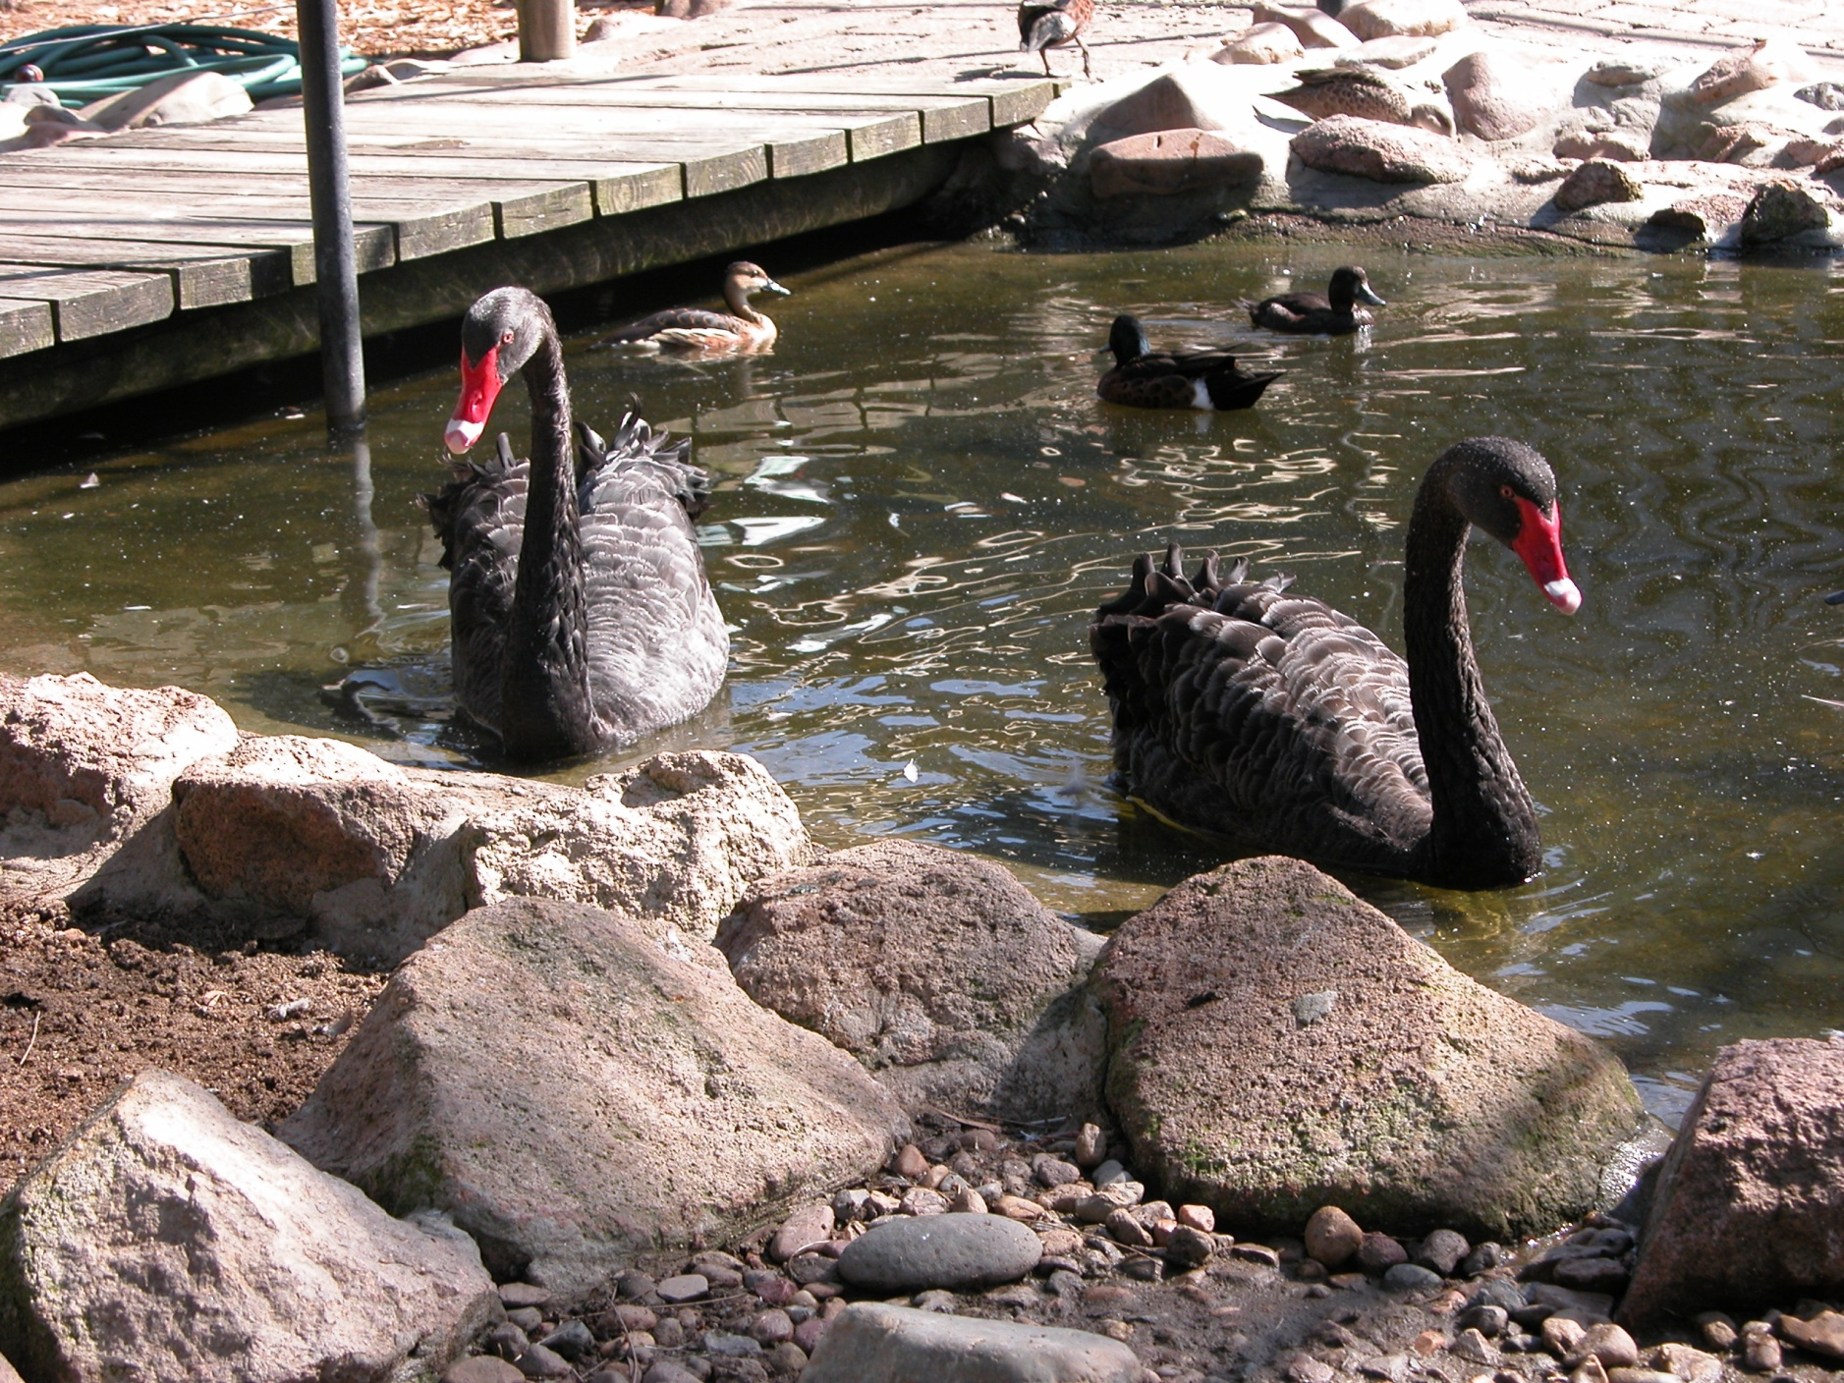
Decide for yourself

Slide 14
WHAT is DIGITAL ASSISTANCE?
Use of Modern Mathematical Computer Packages
  Symbolic, Numeric, Geometric, Visual, Graphical, …
Use of More Specialist Packages or General Purpose Languages
  Fortran, C++, CPLEX, GAP, PARI, MAGMA, …
Use of Web Applications
  Sloane’s Encyclopedia, Inverse Symbolic Calculator, Fractal Explorer, Euclid in Java, Weeks’ Topological Games, …
Use of Web Databases
  Google, MathSciNet, ArXiv, JSTOR, Wikipedia, MathWorld, Planet Math, DLMF, MacTutor, Amazon, …, Wolfram Alpha (??)
All entail data-mining [“exploratory experimentation” and “widening technology” as in pharmacology, astrophysics, biotech… (Franklin)]
  Clearly the boundaries are blurred and getting blurrier
  Judgments of a given source’s quality vary and are context dependent
“Knowing things is very 20th century. You just need to be able to find things.”- Danny Hillis on how Google has already changed how we think in Achenblog, July 1 2008
  - changing cognitive styles

Slide 15
EXPLORATORY EXPERIMENTATION
2004 Laura Franklin argues that Steinle's “exploratory experimentation” facilitated by “widening technology”, as in pharmacology, astrophysics, medicine, and biotechnology, is leading to a reassessment of what legitimates experiment; in that a “local model" is not now prerequisite.
2008 Hendrik Sørenson cogently argues that experimental mathematics (as ‘defined’ below) is following similar tracks:
“These aspects of exploratory experimentation and wide instrumentation originate from the philosophy of (natural) science and have not been much developed in the context of experimental mathematics. However, I claim that e.g. the importance of wide instrumentation for an exploratory approach to experiments that includes concept formation is also pertinent to mathematics.”
  In consequence, boundaries between mathematics and the natural sciences and between inductive and deductive reasoning are blurred and getting more so.

Slide 16
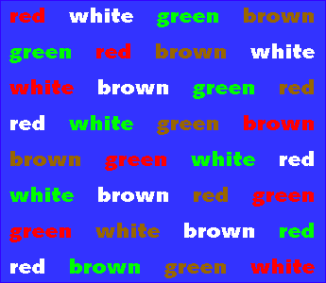
CHANGING USER EXPERIENCE and EXPECTATIONS
What is attention? (Stroop test, 1935)
Say the color represented by the word.
Say the color represented by the font color.
High (young) multitaskers perform #2 very easily. They are great at suppressing information.
http://www.snre.umich.edu/eplab/demos/st0/stroop_program/stroopgraphicnonshockwave.gif
Acknowledgements: Cliff Nass, CHIME lab, Stanford (interference and twitter?)
Notes:
www.burtongroup.com
16

Slide 17
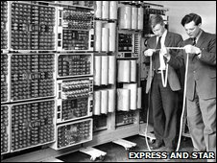
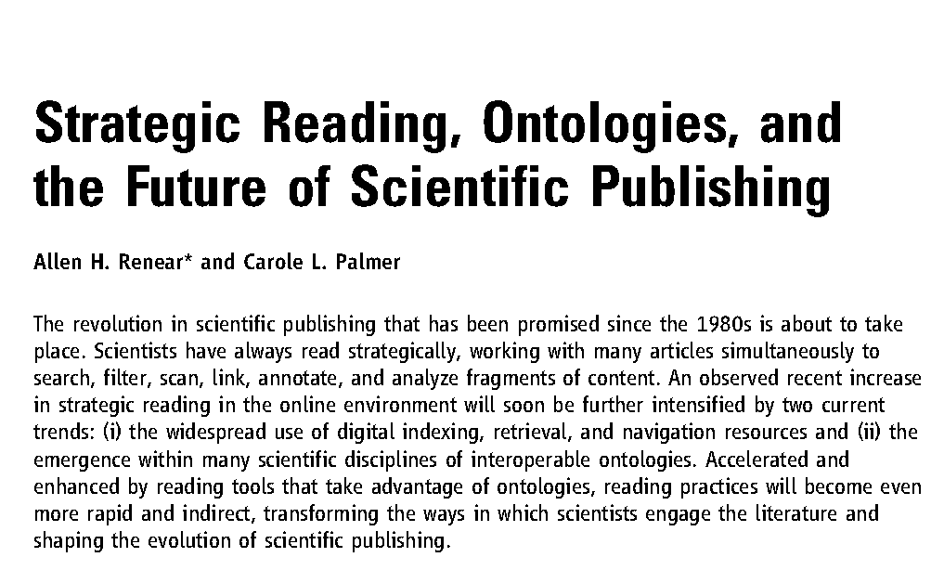
Other Cognitive Shifts
Harwell 1951-1973
Science Online August 13, 2009
Potentially hostile to mathematical research patterns

Slide 18
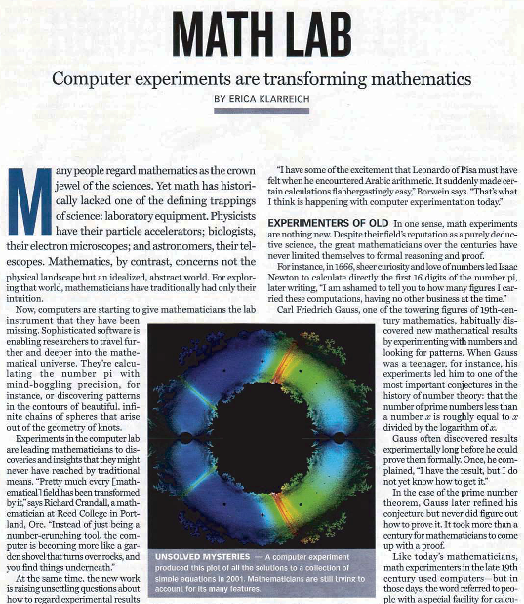
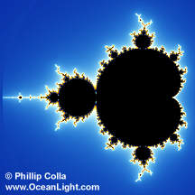
Experimental Mathodology
Experimental Mathodology
Gaining insight and intuition
Discovering new relationships
Visualizing math principles
Testing and especially falsifying conjectures
Exploring a possible result to see if it merits formal proof
Suggesting approaches for formal proof
Computing replacing lengthy hand derivations
Confirming analytically derived results
Science News 2004
“Computers are useless, they can only give answers.” Pablo Picasso
Really?
Comparing –y²ln(y) (red) to y-y² and y²-y⁴

Slide 19
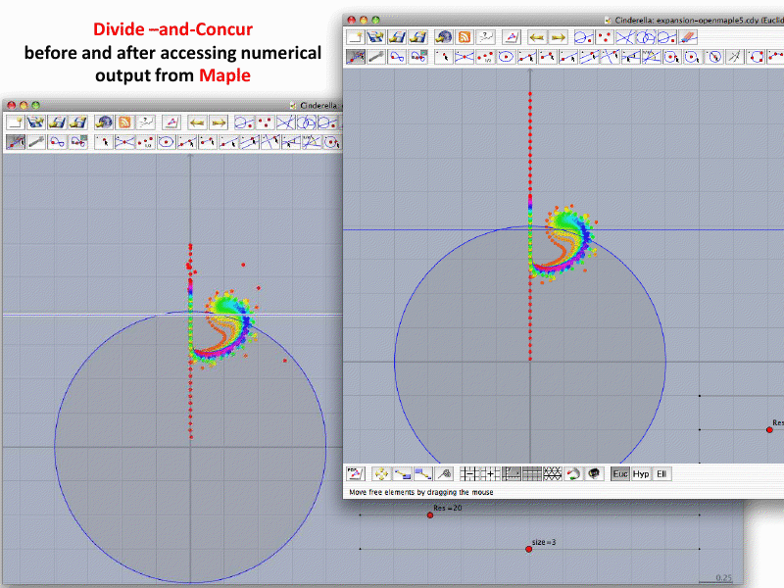
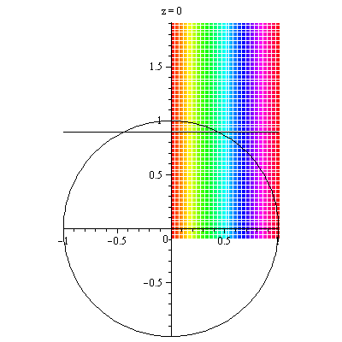
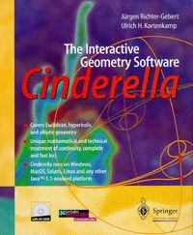
CAS+IGP: the Grief is in the GUI
Correct picture after calling Maple
Numerical errors in using double precision
Notes:
Link is expansion.cdy

Slide 20
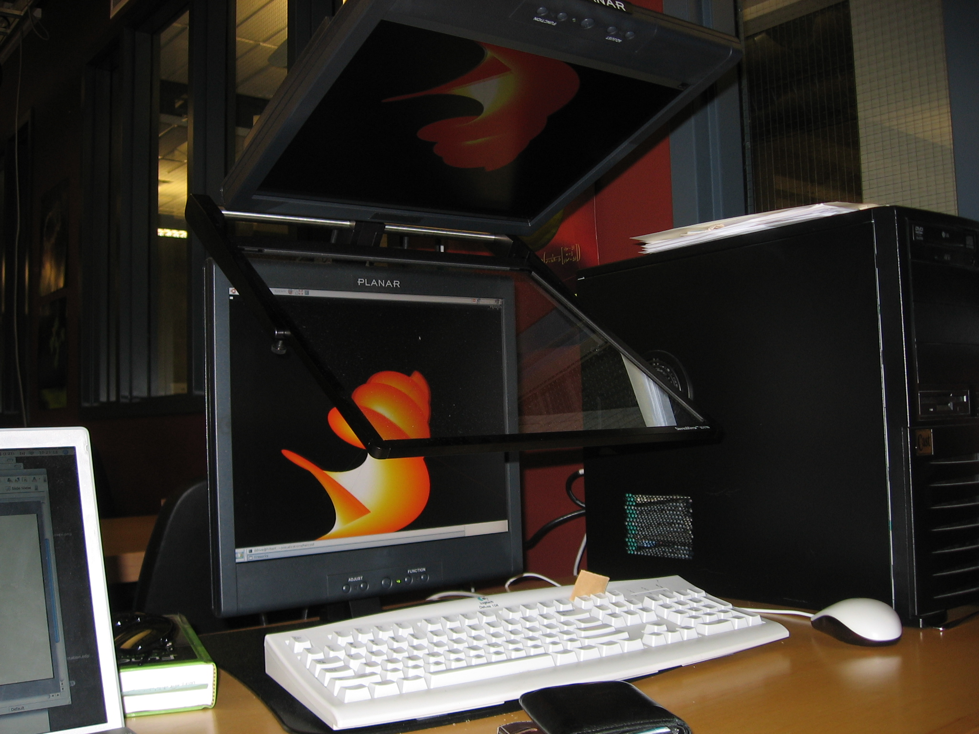
Cost effective 3D visualization in 2007

Slide 21
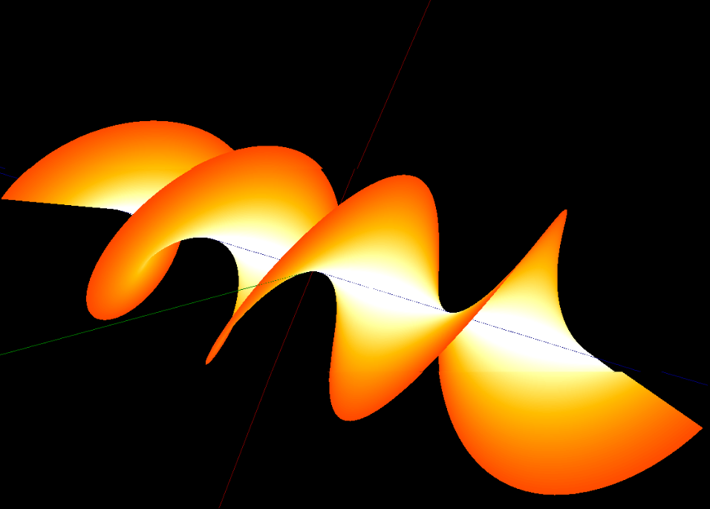
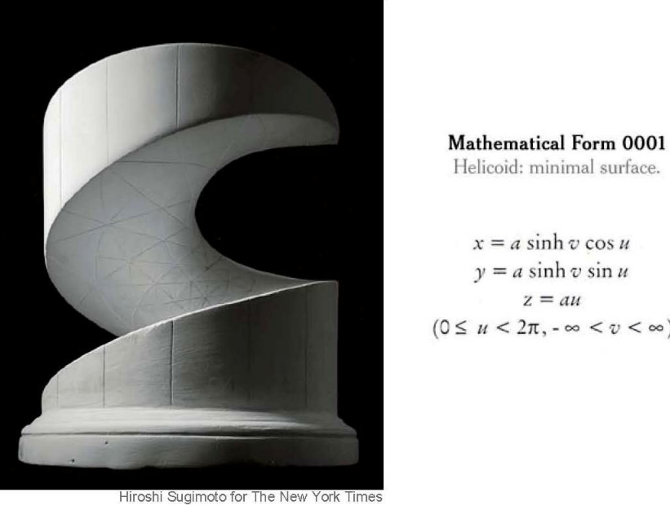
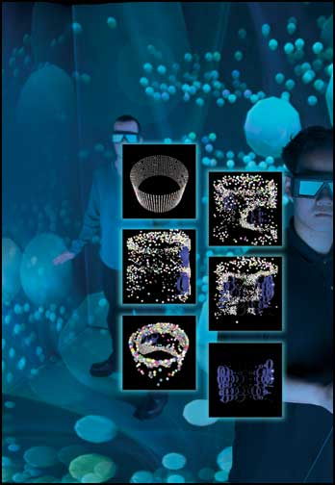
3D in action
19th C model
recent photo
and 21st C rendition
19C plaster model
20C NYT photo
21C image
2005 Notices of the AMS cover on Experimental Mathematics
showing polyhedra
in a 3D- immersive reality “cave” in Vancouver

Slide 22
PARTII. CHRONOLOGY of ISC and FRIENDS
1973 Sloane’s Handbook of Integer Sequences
1978 Ferguson finds PSLQ Integer Relation Algorithm
1985 Sloane’s Encyclopaedia of Integer Sequences
  with Plouffe (5,000 entries)
1990 Handbook of Real Numbers (100,000:16Mb)
The Inverse Symbolic Calculator (ISC)
  bin scripts/JAVA (10Gb: wanted by GNU)
1995 The Colour Calculator
1996 Sloane’s Online Encyclopaedia (OEIS) (150,000)
1999 “Identify” added to Maple
ISC2.0 (Python + Cherry Pie) multi-threaded
  less lookup, more preprocessing and computing

Slide 23
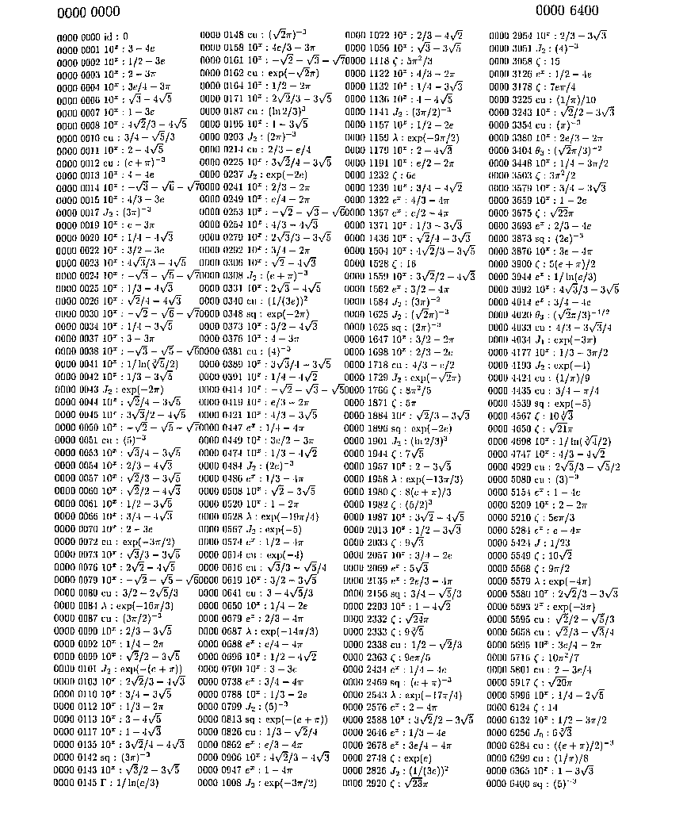
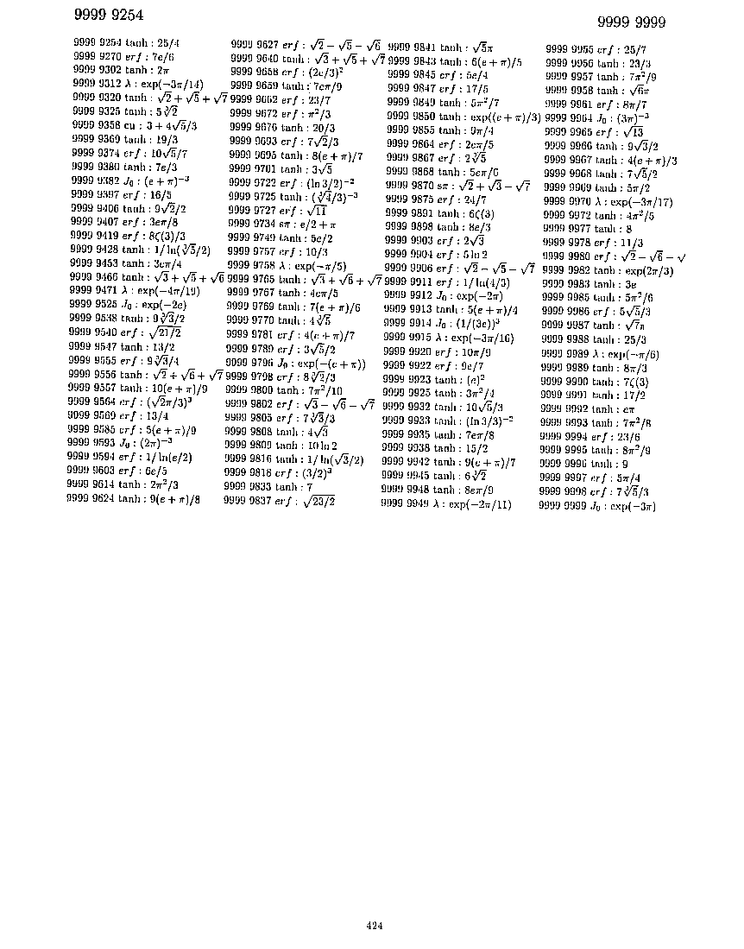
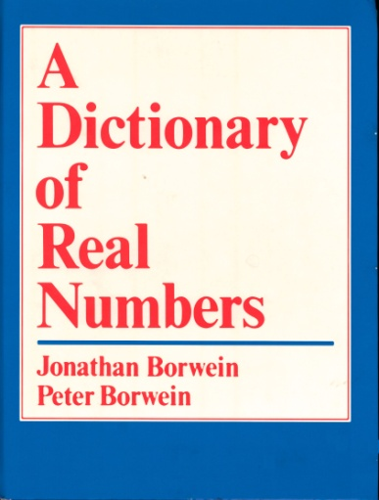
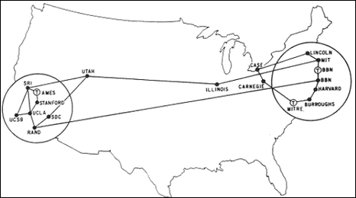
1988-90 A DICTIONARY of REAL NUMBERS
8 pages of preface and 424 of numbers in [0,1]
Very dense!
1989 It took Dalhousie University’s central DEC an afternoon to compress it to 16Mb
ARPA Net in 1969
Notes:
Add blowup

Slide 24
1988-90 A DICTIONARY of REAL NUMBERS
8 pages of preface and 424 of numbers in [0,1]
8 digits after the decimal point:
Notes:
Add blowup

Slide 25
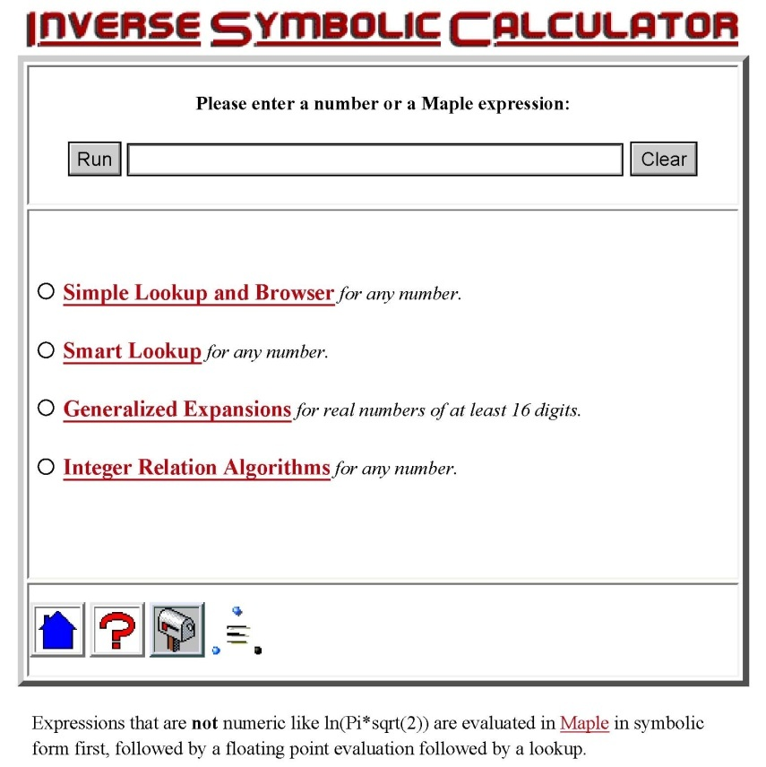
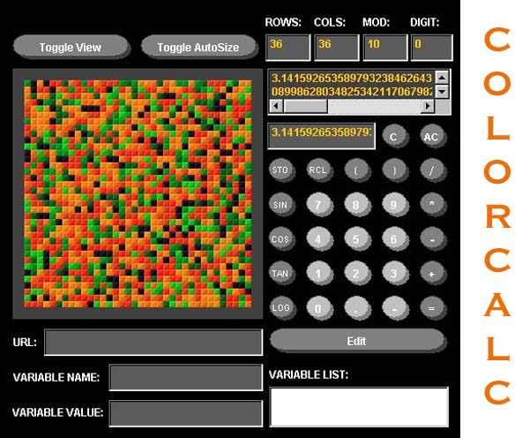

COLOR and INVERSE CALCULATORS (1995)
Inverse Symbolic Computation
Inferring mathematical structure from numerical data
    Mixes large table lookup, integer relation methods and intelligent preprocessing – needs micro-parallelism
    It faces the “curse of exponentiality”
    Implemented as identify in Maple
3.14626437
Input of π
identify(sqrt(2.)+sqrt(3.))

Slide 26
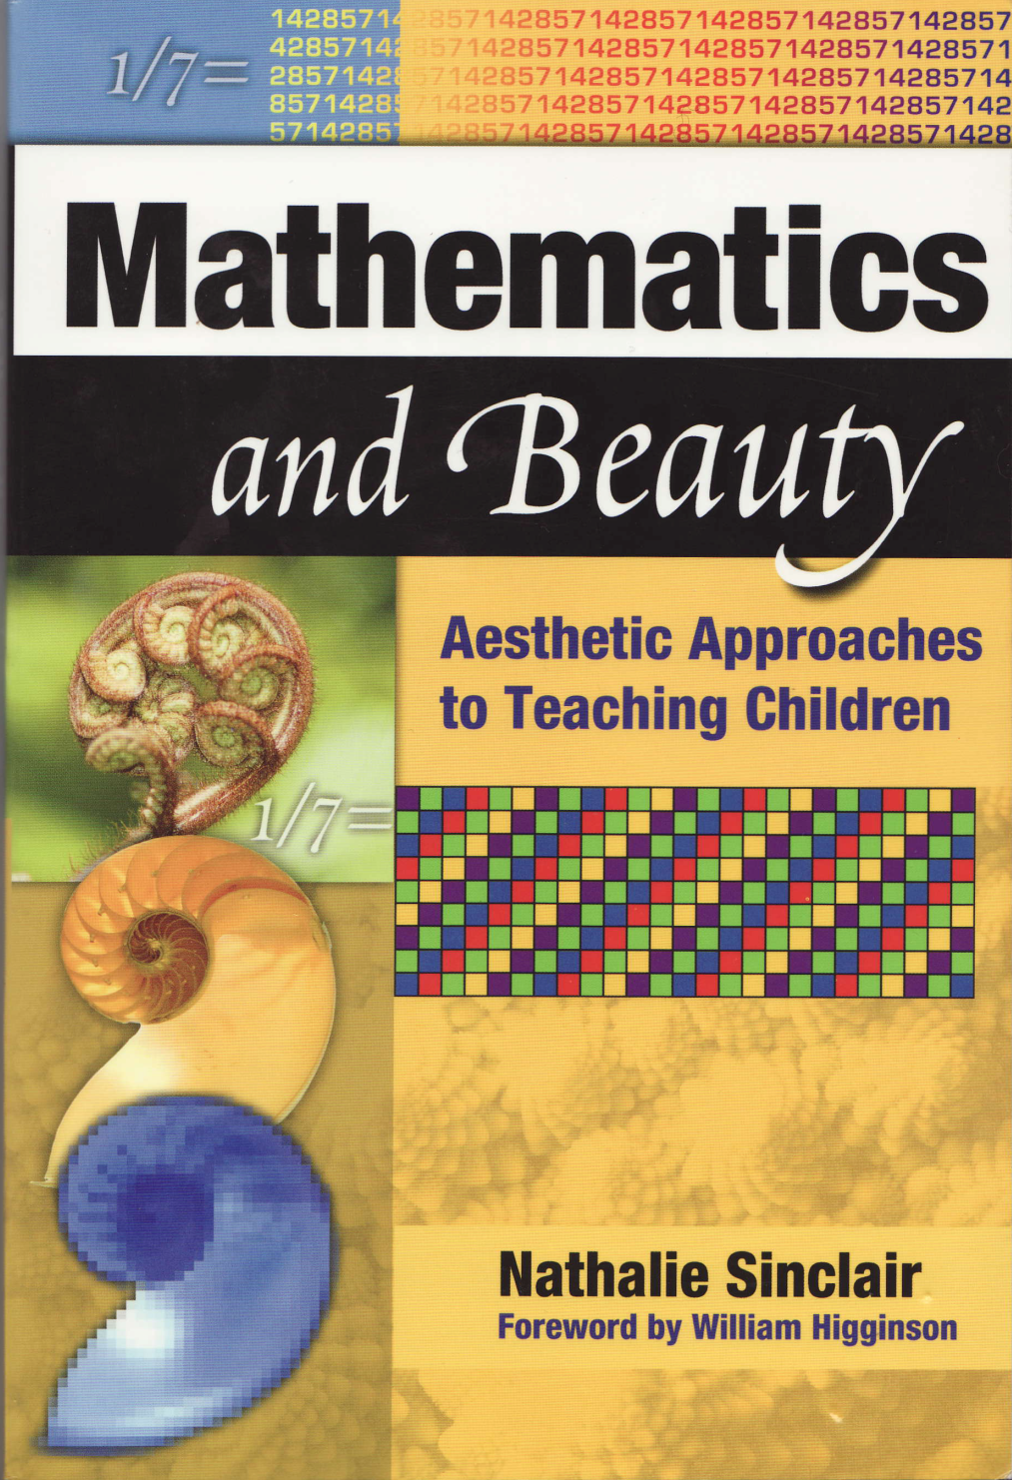
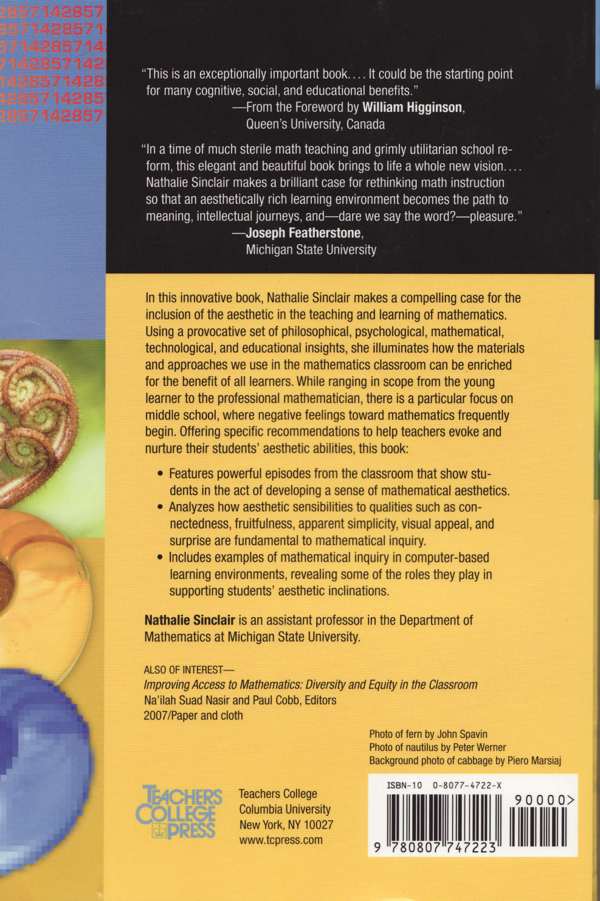
MATHEMATICS and BEAUTY 2006

Slide 27
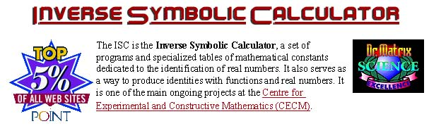
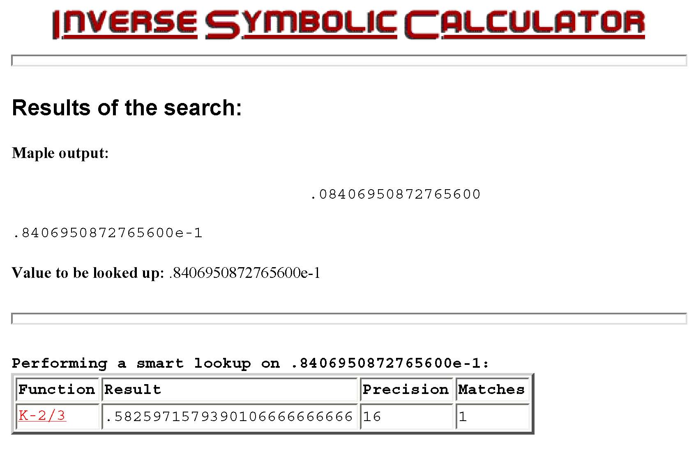
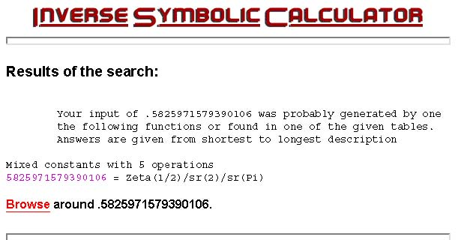
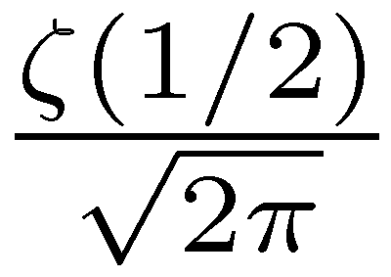
ENTERING
evalf(Sum(k^k/k!/exp(k)-1/sqrt(2*Pi*k),k=1..infinity),16)
‘Simple Lookup’ fails. ‘Smart Lookup’ gives:
= K

Slide 28
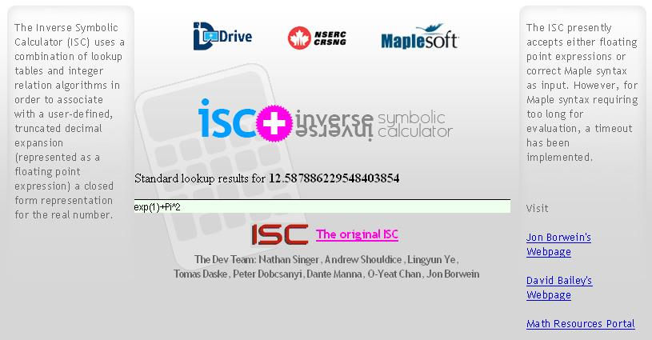
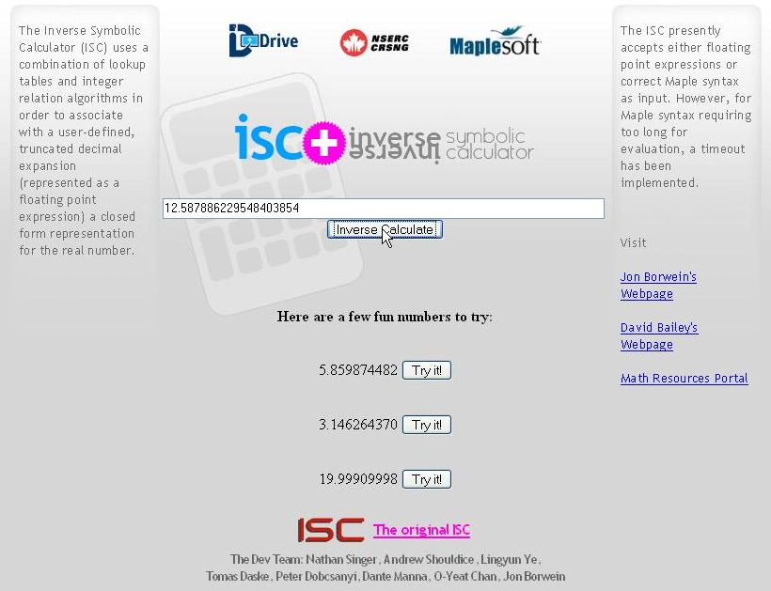



The ISC in Action
Input of 
ISC+ runs on Glooscap
Less lookup & more algorithms than 1995

Slide 29

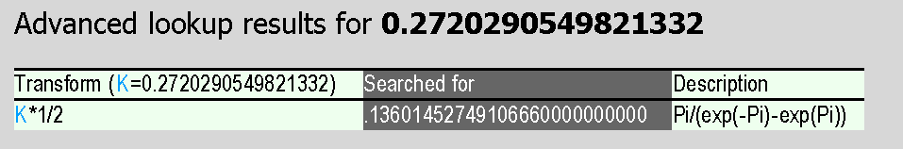

IDENTIFY and ISC IN ACTION
ISC does more for a naive user identify does more for an experienced user
19.999099979
4.599873743272336

Slide 30
A HOMEWORK CHALLENGE

Slide 31

OEIS in ACTION

Slide 32

“Nature laughs at the difficulty of Integration” - Lagrange
"A heavy warning used to be given [by lecturers] that pictures are not rigorous; this has never had its bluff called and has permanently frightened its victims into playing for safety. Some pictures, of course, are not rigorous, but I should say most are (and I use them whenever possible myself).” - J. E. Littlewood, 1885-1977

Slide 33

End of Part II
Part III is on Integer Relation Methods
www.carma.newcastle.edu.au/~jb616/papers.html#TALKS
maple.ini file used in the sequel

Slide 34
PSLQ: INTEGER RELATION ALGORITHMS: WHAT THEY ARE
Let (x_{n}) be a vector of real numbers. An integer relation algorithm finds integers (a_{n}) such that
or provides an exclusion bound
  i.e., testing linear independence over Q
At present, the PSLQ algorithm of mathematician-sculptor Helaman Ferguson is the best known integer relation algorithm.
High precision arithmetic software is required: at least d £ n digits, where d is the size (in digits) of the largest of the integers a_{k}.

Slide 35


INTEGER RELATION ALGORITHMS: HOW THEY WORK
Let (x_{n}) be a vector of real numbers. An integer relation algorithm finds integers (a_{n}) such that
or provides an exclusion bound.

Slide 36

INTEGER RELATION ALGORITHMS: HOW THEY WORK
PSLQ is a combinatorial optimization algorithm designed for (pure) mathematics
The method is “self-diagnosing”---- the error drops precipitously when an identity is found. And basis coefficients are “small”.

Slide 37

TOP TEN ALGORITHMS
integer relation detection (PSLQ, 1997) was the most recent of the top ten

Slide 38


HELAMAN FERGUSON
SCULPTOR and MATHEMATICIAN

Slide 39

Ferguson’s Sculpture

Slide 40



MADELUNG’s CONSTANT
David Borwein CMS Career Award
This polished solid silicon bronze sculpture is inspired by the work of David Borwein, his sons and colleagues, on the conditional series above for salt, Madelung's constant. This series can be summed to uncountably many constants; one is Madelung's constant for electro-chemical stability of sodium chloride.
This constant is a period of an elliptic curve, a real surface in four dimensions. There are uncountably many ways to imagine that surface in three dimensions; one has negative gaussian curvature and is the tangible form of this sculpture. (As described by the artist.)
Notes:
Insert Helaman

Slide 41

Cartoon

Slide 42


INTEGER RELATION ALGORITHMS: WHAT THEY DO: ELEMENTARY EXAMPLES
An application was to determine explicitly the 4th and 5th bifurcation points of the logistics curve have degrees 256.

Slide 43



ALGEBRAIC INDEPENDENCE
In the same fashion we can determine whether numbers ®₁,...,®_{m} are algebraically independent by looking at all products
This rapidly becomes prohibitive for m or n large but is quite effective for small values.
Can this be improved by structured/iterated use?

Slide 44

FINALIZING FORMULAE
If we try with arctan(1/238) we obtain huge integers
In his head

Slide 45

INTEGER RELATIONS in MAPLE
Maple also implements the Wilf-Zeilberger algorithm
Mathematica can only recognize algebraic numbers

Slide 46
INTEGER RELATION ALGORITHMS: WHAT THEY DO: ADVANCED EXAMPLES
THE BBP FORMULA FOR PI
PHYSICAL INTEGRALS
  ISING AND QUANTUM FIELD THEORY
APERY SUMS
  AND GENERATING FUNCTIONS
RAMANUJAN SERIES FOR 1/¼^{N}

Slide 47

The BBP FORMULA for Pi
In 1996 Bailey, P. Borwein and Plouffe, using PSLQ for months, discovered this formula for π:
Indeed, this formula permits one to directly calculate binary or hexadecimal (base-16) digits of π beginning at an arbitrary starting position n, without needing to calculate any of the first n-1 digits.
A finalist for the Edge of Computation Prize, it has been used in compilers, in a record web computation, and in a trillion-digit computation of Pi.

Slide 48



PHYSICAL INTEGRALS (2006-2008)
The following integrals arise independently in mathematical physics in Quantum Field Theory and in Ising Theory:
We first showed that this can be transformed to a 1-D integral:
where K₀ is a modified Bessel function. We then (with care) computed 400-digit numerical values (over-kill but who knew), from which we found with PSLQ these (now proven) arithmetic results:

Slide 49


IDENTIFYING THE LIMIT WITH THE ISC (2.0)
We discovered the limit result as follows: We first calculated:
We then used the Inverse Symbolic Calculator, the online numerical constant recognition facility available at:
http://ddrive.cs.dal.ca/~isc/portal
Output: Mixed constants, 2 with elementary transforms.
.6304735033743867 = sr(2)^2/exp(gamma)^2
In other words,
References. Bailey, Borwein and Crandall, “Integrals of the Ising Class," J. Phys. A., 39 (2006)
Bailey, Borwein, Broadhurst and Glasser, “Elliptic integral representation of Bessel moments," J. Phys. A, 41 (2008) [IoP Select]

Slide 50




APERY-LIKE SUMMATIONS
The following formulas for ζ(s) have been known for many decades:
The RH in Maple
These results have led many to speculate that
might be some nice rational or algebraic value.
Sadly (?), PSLQ calculations have established that if Q₅ satisfies a polynomial with degree at most 25, then at least one coefficient has 380 digits. But positive results exist.

Slide 51






APERY OGF’S
Euler (1707-73)
1. via PSLQ to 5,000 digits (120 terms)
Riemann (1826-66)
1
2005 Bailey, Bradley & JMB discovered and proved - in 3Ms - three equivalent binomial identities
2. reduced as hoped
2
3
3. was easily computer proven (Wilf-Zeilberger) (now 2 human proofs)

Slide 52

NEW RAMANUJAN-LIKE IDENTITIES
Guillera (around 2003) found Ramanujan-like identities, including:
where
Guillera proved the first two using the Wilf-Zeilberger algorithm. He ascribed the third to Gourevich, who found it using integer relation methods. It is true but has no hint of a proof…
As far as we can tell there are no higher-order analogues!

Slide 53

... PSLQ Algorithmic Details
The notes we will use are due to Armin Straub
Next week we will try to make the algorithm work over a general Euclidean domain

Slide 54



REFERENCES
www.experimentalmath.info is our website

