Slide 1



Set the Default to Reproducible
Jonathan Borwein, FRSC FAAAS FAA FAMS www.carma.newcastle.edu.au/jon
Director CARMA (Computer Assisted Research Mathematics and Applications)
Laureate Professor University of Newcastle, NSW
“We have a habit in writing articles published in scientific journals to make the work as finished as possible, to cover up all the tracks, to not worry about the blind alleys or describe how you had the wrong idea first, and so on. So there isn't any place to publish, in a dignified manner, what you actually did in order to get to do the work.”
(Richard Feynman, 1918-1988)
Revised 30/08/2008
Revised 29/10/15

Slide 2


Publishing Standards for Computational Science:
“Setting the Default to Reproducible”
Fpr
Mathematical Aspects of Behavioural Economics and Finance November 13-14 2015

Slide 3
Publishing Standards for Computational Science:
“Setting the Default to Reproducible”
BY VICTORIA SToDDEN, JONATHAN Borwein, & DaVID H. BaileY
"'Setting the Default to Reproducible' in Computational Science Research," SIAM News, vol. 46, no. 5 (June 2013), pg. 4-6.
Also
D.H. Bailey, J.M. Borwein and Victoria Stodden, ``Set the default to ‘open’," Notices of the AMS. 60 (6) (2013), 679-680.
D. Bailey, J. Borwein, and V. Stodden. ``Facilitating Reproducibility in Scientific Computing: Principles and Practice." Chapter in Reproducibility - Principles, Problems, Practices. Harald Atmanspacher and Sabine Maasen editors. John Wiley & Sons, New York 2015. In Press.

Slide 4
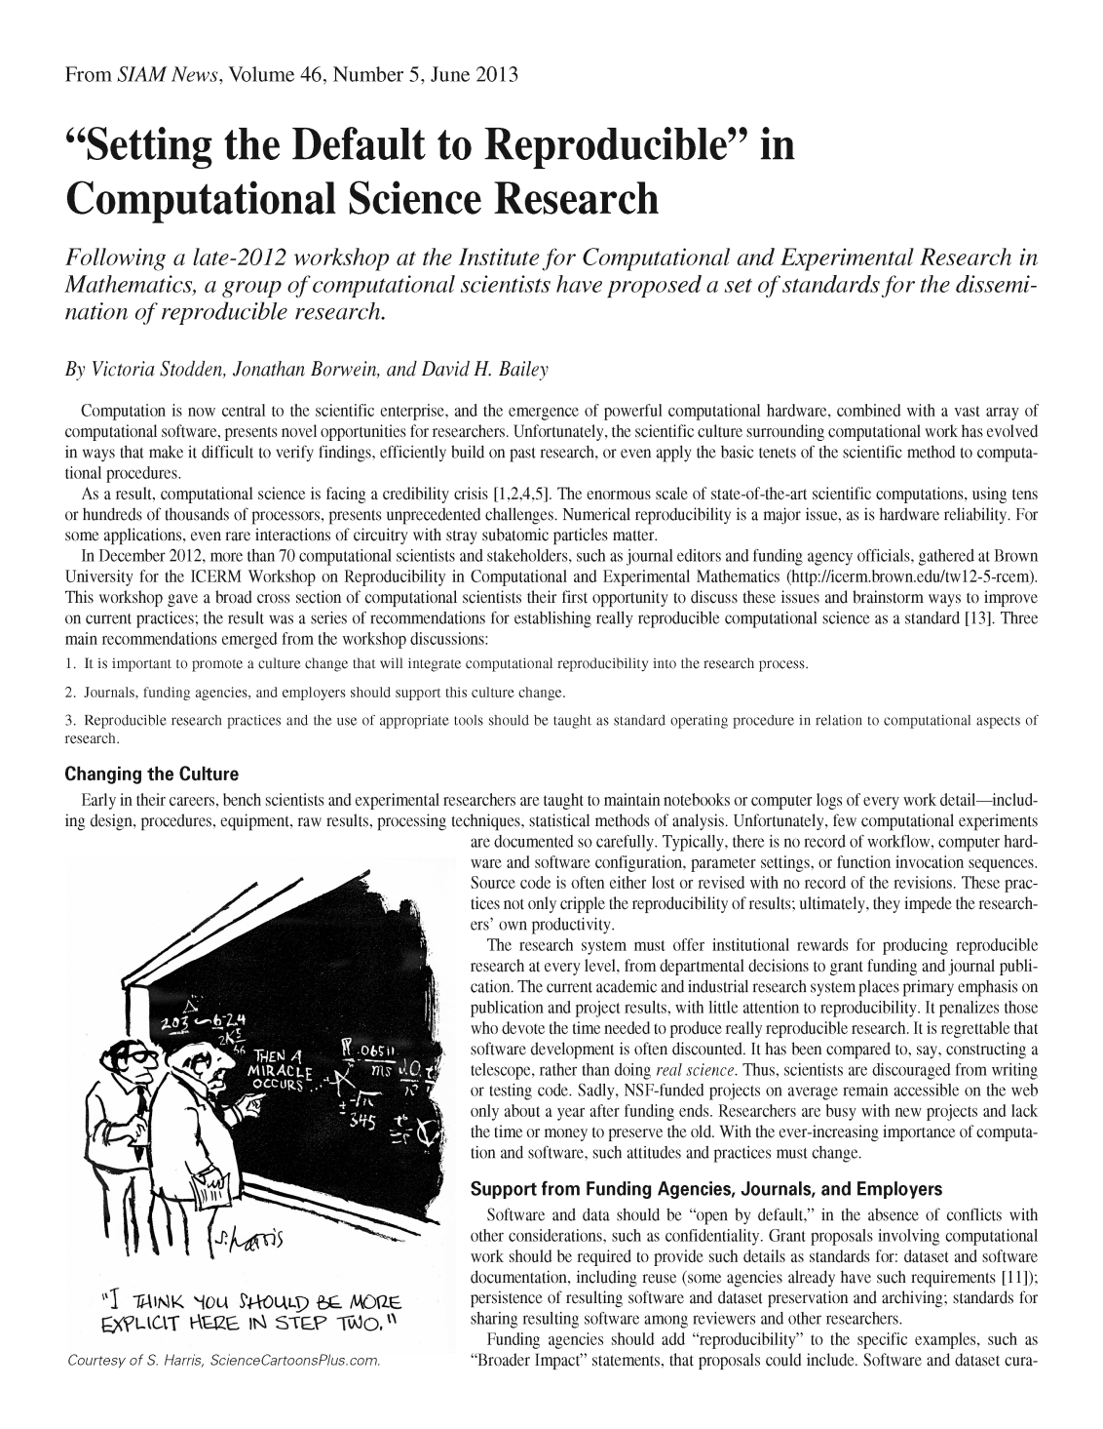
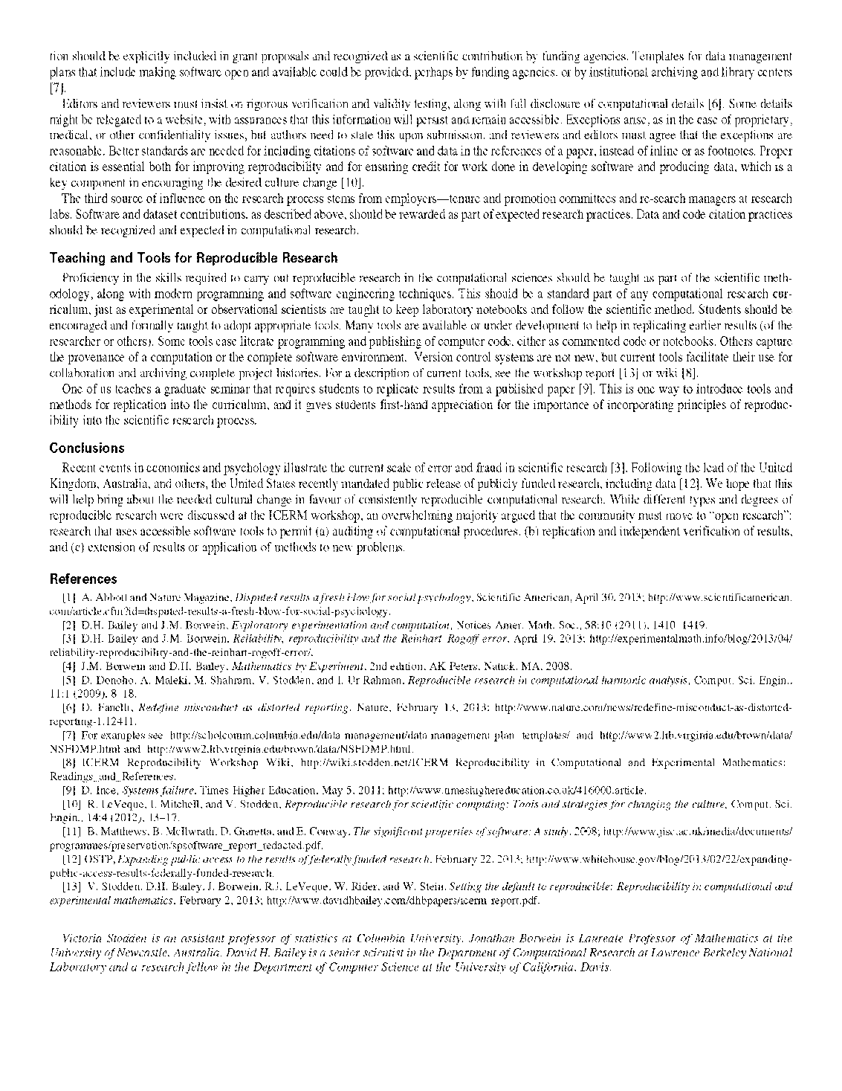

Slide 5
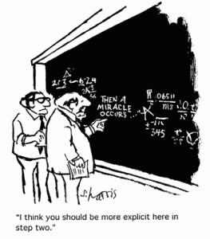

Slide 6
ABSTRACT
Recent research scandals in Economics, Medicine, and Social Psychology [2,3] all reinforce the point that
Secret science is bad science
I will discuss these and the rationale for, events and outcomes of a December 2012 workshop on Reproducibility in Computational and Experimental Mathematics held at the Institute for Research in Computational and Experimental Mathematics (ICERM) at Brown University [1]
In particular, I discuss the meeting’s primary recommendations for a more accountable, reliable, open practice of computational science
Set the Default to "Open": Reproducible Science in the Computer Age: http://www.huffingtonpost.com/david-h-bailey/set-the-default-to-open-r_b_263
Scientific fraud, sloppy science – yes, they do happen https://theconversation.com/profiles/jonathan-borwein-jon-101/articles
The train wreck continues: another social science retraction (May 2015)
https://theconversation.com/the-train-wreck-continues-another-social-science-retraction-42404

Slide 7

ABSTRACT
A group of computational scientists has developed a set of standards to guide the dissemination of reproducible research.
Computation is now central to the scientific enterprise, and the emergence of powerful computational hardware combined with a vast array of computational software, presents novel opportunities for researchers
Unfortunately the scientific culture surrounding computational work has evolved in ways that make it difficult to
  verify findings, efficiently build on past research, or even to apply the basic tenets of the scientific method to computational procedures

Slide 8
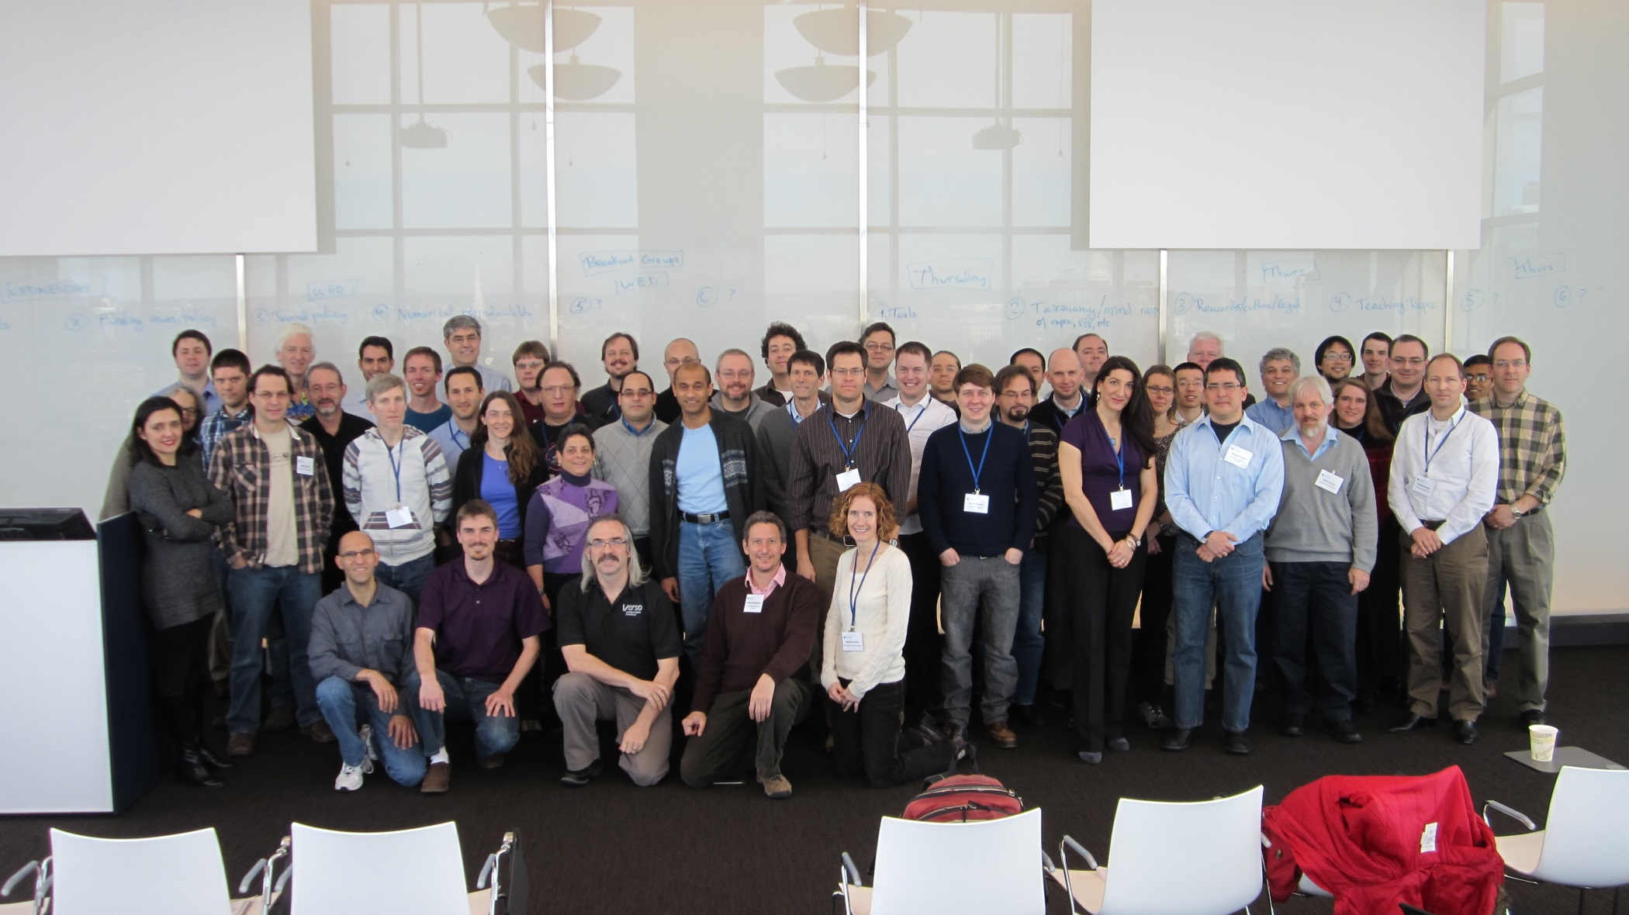
MANY ICERM PARTIPANTS

Slide 9
A CREDIBILITY CRISIS
As a result computational science is facing a large credibility crisis [1-4]
The enormous scale of state-of-the-art scientific computations, using tens or hundreds of thousands of processors, presents unprecedented challenges
Numerical reproducibility is a major issue, as is hardware reliability
For some applications, even rare interactions of circuitry with stray subatomic particles matter

Slide 10
2012 ICERM MEETING
In December of 2012, more than 70 computational scientists and stakeholders such as journal editors and funding agency officials gathered at Brown University for the ICERM Workshop on Reproducibility in Computational and Experimental Mathematics
This workshop provided the first opportunity for a broad cross section of computational scientists to discuss these issues and brainstorm ways to improve on current practices, resulting in a series of recommendations to establish really reproducible computational science as a standard [5]
Main recommendations emerging from the workshop are:

Slide 11
THREE MAIN
RECOMMENDATIONS
It is important to promote a culture change that will integrate computational reproducibility into the research process
Journals, funding agencies, and employers should support this culture change
Reproducible research practices and the use of appropriate tools should be taught as standard operating procedure in relation to computational aspects of research

Slide 12
CHANGING THE CULTURE
Early in their career, bench scientists and experimental researchers are taught to maintain notebooks or computer logs of every work detail
  design, procedures, equipment, raw results, processing techniques, statistical methods of analysis, etc.
Unfortunately few computational experiments are documented so carefully
  Typically, there is no record of workflow, computer hardware and software configuration, parameter settings, or function invocation sequences.
Source code is often lost, or is revised with no record of the revisions
  while crippling reproducibility of results, these practices ultimately impede the researchers’ own productivity

Slide 13
INSTITUTIONAL REWARDS
The research system must offer institutional rewards for producing reproducible research at every level from departmental decisions to grant funding and journal publication
Current academic and industrial research system places primary emphasis on publication and project results and little on reproducibility
It penalizes those devoting time to producing really reproducible research. It is regrettable that software development is often discounted:
  It has been compared disparagingly to, say, constructing a telescope, rather than doing real science
Thus, scientists are discouraged from spending time writing or testing code. Sadly, NSF-funded projects on average remain accessible on the web only about a year after funding ends.
  Researchers are busy with new projects and lack time or money to preserve the old. With the ever-increasing importance of computation and software, such attitudes & practices must change.

Slide 14
FUNDING AGENCIES
JOURNALS AND EMPLOYERS
Should Support This Change. Software and data should be “open by default” unless it conflicts with other considerations, such as confidentiality. Grant proposals involving computational work should be required to provide details such as standards for:
dataset and software documentation, including reuse (some agencies already have such requirements [6])
persistence of resulting software and dataset preservation and archiving
standards for sharing resulting software among reviewers and other researchers

Slide 15
FUNDING AGENCIES
Agencies should add “reproducible research” to the list of specific examples that proposals could include in their requirements
  such as “Broader Impact” or “value to Australia” statements
Software and dataset curation should be explicitly included in grant proposals and recognized as a scientific contribution by funding agencies
  templates for data management plans could be made available that include making software open and available, perhaps by funding agencies, or by institutional archiving and library centers [7]

Slide 16
EDITORS AND REVIEWERS
Must insist on rigorous verification and validity testing, along with full disclosure of computational details [8]
  some details might be relegated to website, with assurances this information will persist and remain accessible
  exceptions exist, such as where proprietary, medical, or other confidentiality issues arise, but authors need to state this upon submission, and reviewers and editors must agree such exceptions are reasonable
There is also a need for better standards on how to include citations for software and data in the references of a paper, instead of inline or as footnotes
  proper citation is essential both for improving reproducibility and in order to provide credit for work done developing software and producing data, which is a key component in encouraging the desired culture change [9]

Slide 17
EMPLOYERS
The third source of influence on the research process stems from employers – tenure and promotion committees and research managers at research labs.
Software and dataset contributions, as described in the previous two subsections, should be rewarded as part of expected research practices.
Data and code citation practices should be recognized and expected in computational research.

Slide 18
TEACHING AND TOOLS FOR REPRODCIBLE RESEARCH
Proficiency in the skills required to carry out reproducible research in the computational sciences should be taught as part of the scientific methodology, along with teaching modern programming and software engineering techniques
this should be a standard part of any computational research curriculum, just as experimental or observational scientists are taught to keep a laboratory notebook and follow the scientific method.
Adopting appropriate tools should be encouraged, and formally taught. Many tools exist and are under development to help in replicating past results (by the researcher or others).
  some ease literate programming and publishing of computer code, either as commented code or notebooks.
  others capture provenance of a computation or the complete software environment. Version control systems are not new, but current tools facilitate use for collaboration and archiving complete project histories.
For a description of current tools see workshop report [5] or wiki [10]
  VS teaches graduate seminar requiring students to replicate results from a published paper [11]. This is one way to introduce tools and methods for replication into curriculum; students experience first hand how important it is to incorporate principles of reproducibility into the scientific research process.

Slide 19
CONCLUSION
Recent events in medicine, economics and psychology illustrate the current scale of error and fraud [12].
The United States has recently followed the lead of the United Kingdom, Australia and others in mandating public release of publicly funded research, including data [13]
We hope this helps bring about needed cultural change in favour of consistently reproducible computational research
  While different types and degrees of reproducible research were discussed at ICERM, an overwhelming majority argued the community must move to “open research”: research using accessible software tools to permit
auditing of computational procedures,
replication and independent verification of results, and
extending results or applying methods to new problems.

Slide 20
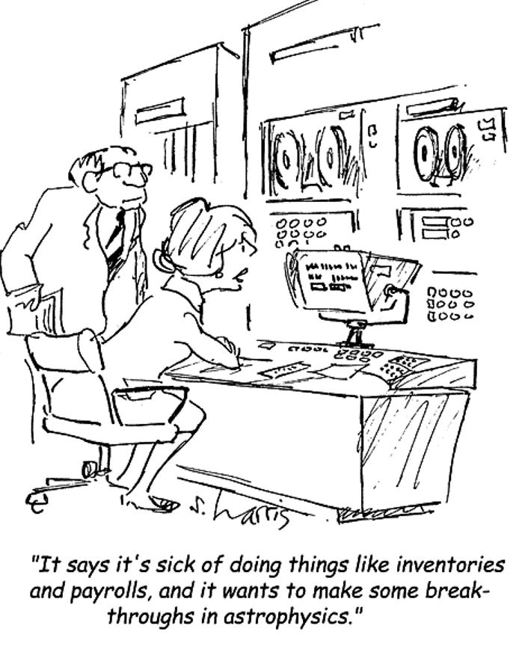
THE FUTURE IS BRIGHT
THANK YOU

Slide 21
REFERENCES
D. Donoho, A. Maleki, M. Shahram, V. Stodden, and I. Ur Rahman. “Reproducible research in computational harmonic analysis.” Computing in Science and Engineering, 11, January 2009.
D. H. Bailey and J. M. Borwein, “Exploratory Experimentation and Computation,” Notices of the AMS, vol. 58 (Nov. 2011), p. 1411-1419.
J. M. Borwein and D. H. Bailey, Mathematics by Experiment, Edition 2, AK Peters, 2008.
A. Abbott and Nature Magazine, “Disputed Results a Fresh Blow for Social Psychology,” Scientific American, April 30, 2013. http://www.scientificamerican.com/article.cfm?id=disputed-results-a-fresh-blow-for-social-psychology
V. Stodden, D. H. Bailey, J. Borwein, R. J. LeVeque, W. Rider and W. Stein, “Setting the Default to Reproducible: Reproducibility in Computational and Experimental Mathematics,” 2 Feb 2013, http://www.davidhbailey.com/dhbpapers/icerm-report.pdf.
B. Matthews, B. McIlwrath, D. Giaretta, and E. Conway. “The significant properties of software: A study.” 2008. http://www.jisc.ac.uk/media/documents/programmes/preservation/spsoftware_report_redacted.pdf.

Slide 22
REFERENCES
For examples see: http://scholcomm.columbia.edu/data-management/data-management-plan- templates/ and http://www2.lib.virginia.edu/brown/data/NSFDMP.html
D. Fanelli, “Redefine misconduct as distorted reporting,” Nature, 13 Feb 2013, available at http://www.nature.com/news/redefine-misconduct-as-distorted-reporting-1.12411.
R. LeVeque, I. Mitchell, and V. Stodden. “Reproducible research for scientific computing: Tools and strategies for changing the culture.” Comp in Science and Engin., 13–17, July 2012.
ICERM Reproducibility Workshop Wiki: http://wiki.stodden.net/ICERM_Reproducibility_in_Computational_and_Experimental_Mathematics:_Readings_and_References
D. Ince, System Failure, Times Higher Education, May 5, 2011. http://www.timeshighereducation.co.uk/416000.article
D. H. Bailey and J. M. Borwein, “Reliability, Reproducibility and the Reinhart-Rogoff error,” https://theconversation.com/the-reinhart-rogoff-error-or-how-not-to-excel-at-economics-13646, April 19, 2013.
OSTP, “Expanding Public Access to the Results of Federally Funded Research,” 22 Feb 2013, available at http://www.whitehouse.gov/blog/2013/02/22/expanding-public-access-results-federally-funded-research

