Slide 1

CARMA: a model for multi-discipline & multi-institution collaboration
Computer-Assisted Research Mathematics and its Applications
Cultivating a Culture of Excellence
Director Laureate Professor Jonathan Borwein FRSC FAAAS FAA FAMS
Co-director Professor George Willis FAA

Slide 2
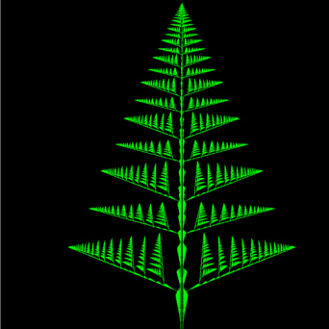
PART I: focus on the future
"A centre of excellence is, by definition, a place where second class people may perform first class work.”
Ernest Rutherford
"A truly popular lecture cannot teach, and a lecture that truly teaches cannot be popular.”
Michael Faraday
Fractal Norfolk pine

Slide 3
Abstract
Abstract. I will briefly describe our centre for Computer-assisted research mathematics and its applications and some of its strengths.
I intend this as a starting point for discussions of the role of collaboration and of mathematical modelling in the biomedical sciences.

Slide 4
Axioms for Collaboration
The first [axiom] said that when one wrote to the other (they often preferred to exchange thoughts in writing instead of orally), it was completely indifferent whether what they said was right or wrong. As Hardy put it, otherwise they could not write completely as they pleased, but would have to feel a certain responsibility thereby.
The second axiom was to the effect that, when one received a letter from the other, he was under no obligation whatsoever to read it, let alone answer it, --- because, as they said, it might be that the recipient of the letter would prefer not to work at that particular time, or perhaps that he was just then interested in other problems....
https://www.carma.newcastle.edu.au/jon/IICandC.pdf
G.H. Hardy (1877-1947) & J.E. Littlewood (1885-1977)

Slide 5
Axioms for Collaboration
And, finally, the fourth, and perhaps most important axiom, stated that it was quite indifferent if one of them had not contributed the least bit to the contents of a paper under their common name; otherwise there would constantly arise quarrels and difficulties in that now one, and now the other, would oppose being named coauthor.
• Pretty good rules for collaboration a century later
• Shared (even expressed) expectations are crucial!
• IP issues & treatment of students often need addressing (dot-com)
The third axiom was to the effect that, although it did not really matter if they both thought about the same detail, still, it was preferable that they did not.

Slide 6
My background
Pure Math (71) → Optimization (Multicriteria Choice, DPhil 74) → OR + Computational Science (84)→ High Performance Computing, Imaging (88) → Collaborative Technology (04) → CARMA (08)
Spun off MathResources Inc (90-94) IRAP/Angel funding (97-03) $3M Regional Development money
Many employees, products, prizes, partners (SGI, Casio, Maple, NSF, MAA), no IPO.
I wouldn’t have felt comfortable writing recent books without studying some Logic, Philosophy & History (of Science)
One of most challenging experiences was building WestGrid and ACENet; coauthoring and advocating the 2005 Long Range Plan for Advanced Computation in Canada (2003-2005)
E.g., to Science Advisor, Grant Councils, Space Agency, Politicos
Led to recent $500 million infusion for Compute Canada

Slide 7
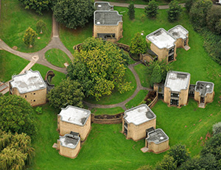
2016 activities: KPIs
Research centres are the foundation of 21st century mathematical research:
Newton, Fields, PIMS, MSRI, DIMACS, Max Planck, IMPA, …
They are our membership fee into the international community
Work towards KPIs through:
International recognition
National leadership
Application-informed pure research
Alzheimer's: Stanford & Florida(?) Medical Schools
Photonic imaging data: Stefan Hell, 2014 Chem. Nobel
Research-informed R&D
Chemistry, radiology, pharmacology

Slide 8
2016-17 activities: events
Selected recent and upcoming events:
December 2015: Mathematical Physics (ANZAMP), Guttmann 70th (Osborne), KozWaves 2 (Meylan)
February June/July: two months of focus on Symmetries (Willis) February Optimisation SPOM 6 (Borwein)
February 17: Effective Visualisation (EViMS3) (Borwein)
September: Number Theory (NTDU 4) (Hussain)
December: 39th Australasian Conference on Combinatorial Mathematics and Combinatorial Computing (Kalinowski)
July 2017: 7th World Fixed Point Conference (planning, funding)
Industry, community and business engagement activities:
2016 Various n.u.m.e.r.i.c. events with teachers and/or students
April: Newcastle Maths Educators (NMEC II) (IMSITE, Osborne)
July 2017: AMSI Optimise — and a week for practitioners

Slide 9
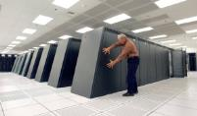
Mathematical foundations
Imaging
Graph theory
Cryptography
Logistics
Analysis
Algebra
Combinatorics
Fluid mechanics
Finance
Number theory
Operations research
Optimisation
Control

Slide 10
2016 activities: grants
Intended grant submissions:
Discovery grants
Wadim Zudilin (Analytic Number Theory)
Mumtaz Hussain (Analytic Number Theory)
Ali Eshragh (Statistical Optimisation)
Bishnu Lamichhane (Computational Fluid Dynamics)
Mike Meylan (Wave-induced Interstitial Ice Breakup)
Björn Rüffer (Non-smooth Control Theory)
DECRAs
Mumtaz Hussain
Laureate professorships
Jon Borwein, George Willis
Linkage grants
Yuqing Lin X2 ( in Health informatics, submitted Nov 12)
All are either highly computational or ‘experimental’

Slide 11
2020 impact
Impact of CARMA on New Futures by 2020
EQUITY and SOCIAL JUSTICE
CARMA’s n.u.m.e.r.i.c. group (Newcastle University Mathematical Sciences Education Research Initiatives Collective) is part of a deep tradition in the mathematical sciences at Newcastle of care and involvement in education at all levels
We are invested in this tradition and are excited about the prospects of working with AMSI/BHP Billiton to ensure that women are retained in mathematics and so able to pursue STEM careers
CARMA attempts to reawaken research inactive academic staff

Slide 12
2020 impact
Impact of CARMA on New Futures by 2020
EXCELLENCE
Scores of ‘5’ for applied mathematics (2 of the 3 given in total) in the 2010 and 2012 ERA are emblematic of the quality of research being done within and around CARMA
Score of ‘5’ in Statistics in 2015
This is leading to increasing student numbers in our School
24 Vacation Scholars in maths and stats this summer
2015: 21 maths RHD students (up from 12 in 2009)

Slide 13
2020 impact
Impact of CARMA on New Futures by 2020
ENGAGEMENT
The quantity of seminars/workshops/research visitors of CARMA illustrates our claim that we are highly engaged. Many CARMA members pursue active outreach activities. Most events are streamed and recorded for external audiences.
In addition, the Director with others has written 44 articles for the Conversation (attracting 1.35 million readers) and 35 articles for the Huffington Post.
Six published books generated directly by CARMA activities

Slide 14
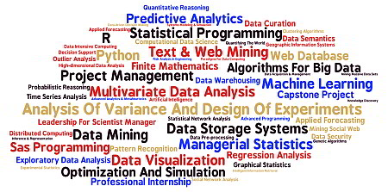
2020 impact
Impact of CARMA on New Futures by 2020
INNOVATION
Throughout the mathematics research community CARMA’s name is now synonymous with innovative uses of technology in research and with excellence in all our core areas
MIDAS (Masters in Data Analytics and Science)
a new Masters programme being planned

Slide 15
2020 impact
Impact of CARMA on New Futures by 2020
INTEGRITY
Especially with ECRs we make sure that appropriate professional conduct is discussed frequently
as is the culture of research
We are highly engaged in the “Reproducible Computational Science” community
Two fully-funded week-long workshops (2012, 2014) at the Institute for Computational and Experimental Research Mathematics ICERM (Brown University)
Forthcoming chapter in Reproducibility — Principles, Problems, Practices (Wiley, 2016)

Slide 16

2020 impact
Impact of CARMA on New Futures by 2020
SUSTAINABILITY
Cyber-security, cryptography, reproducible computational science, informatics and education of a mathematically-enabled population underpin sustainable enterprises and all are CARMA research focuses

Slide 17
PART II: CARMA’s strengths

Slide 18
"A research policy does not consist of programs, but of hiring high-quality scientists. When you hire someone good, you've made your research policy for the next 20 years."
Chief CNRS advisor Vincent Courtillot
in “New CNRS Chief Gets Marching Orders”, Science, 18 July, 1997

Slide 19
CARMA
40 members, 10 student members,
9 external members
CARMA members
CARMA research
CARMA support
CARMA visitors
CARMA events
CARMA research groups
CARMA workshops
CARMA collaboration
CARMA technical
CARMA facilities
Over 100 international visitors
Over 750 events 2009-2015
24 conferences and meetings,
11 short-course lecture series
Over 500 hours of ACE
support per year

Slide 20
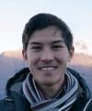

Recent successes
Our past 12 months
Four 2016 ARC Discovery Grants (of UoN’s15)
Jon Borwein and Jeff Hogan, Murray Elder, Chris Kellett, Mirka Miller
2 Fellowships and one Distinguished Scholar (Jon Borwein)
National distinguished teaching award (Peter Howley)
Five RHD prizes and awards
“Test of Time” award, Super Computing 2015 (David Bailey)
Schools poster competition produced international winners
Administrative Staff Award (FSCIT) (Juliane Turner)

Slide 21
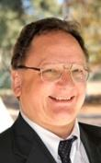










































Members

Slide 22
Research groups
Experimental mathematics
Jon Borwein, Wadim Zudilin, Ohad Giladi, Paul Vrbik, James Wan
Discrete mathematics and Graph theory
Mirka Miller, Joe Ryan, Thomas Kalinowski, Judy-anne Osborn, Ali Eshragh, Richard Brent
MAFFIA (financial mathematics)
Jon Borwein, David Bailey, Amir Salehipour, Ali Eshragh
n.u.m.e.r.i.c.
Judy-anne Osborn, Peter Howley, Malcolm Roberts, Elena Prieto
Number theory
Wadim Zudilin, Michael Coons, Jon Borwein, Richard Brent, Mumtaz Hussain
Applied functional analysis and Optimisation
Jon Borwein, Brailey Sims, Jeff Hogan, Bishnu Lamichhane, Mike Meylan
Symmetry Groups aka The Group Group
George Willis, Murray Elder, Colin Reed, David Robertson
Control, Optimisation and Operations research
Chris Kellett, Björn Rüffer, Masoud Talebian, Thomas Kalinowski, Jon Borwein, new professor
Category 1 grant-holders in shown yellow
Post-docs shown in pink

Slide 23
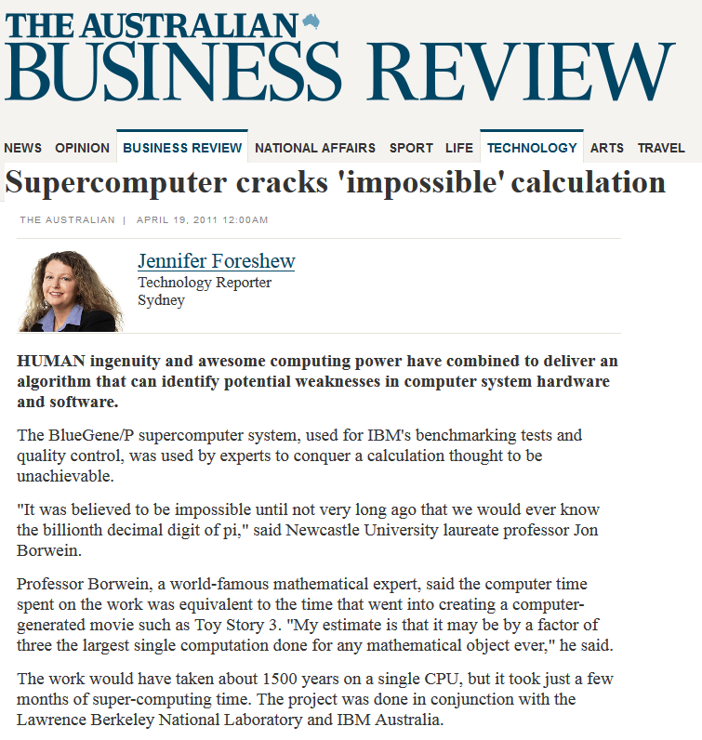

Notable achievements
2013: Blue Gene 2,000 rack-day computation
2014: Mike Meylan in Nature

Slide 24
A strong backbone
A plethora of resources
Extensive research support experience
technical and administrative
Strong, customised web presence
e.g. Mahler, D Borwein, DocServer archives
event and conference websites
Events and conference management systems
Local HPC supplemented by UON grid
Remote collaboration expertise
Web development expertise
interactive web apps for research projects

Slide 25
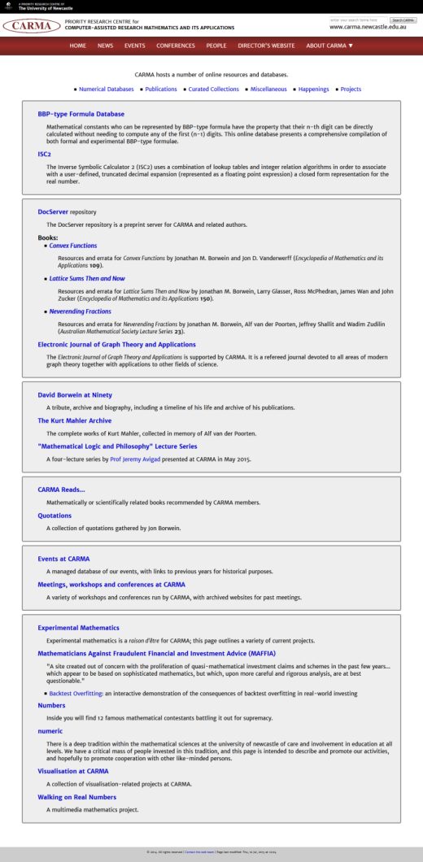
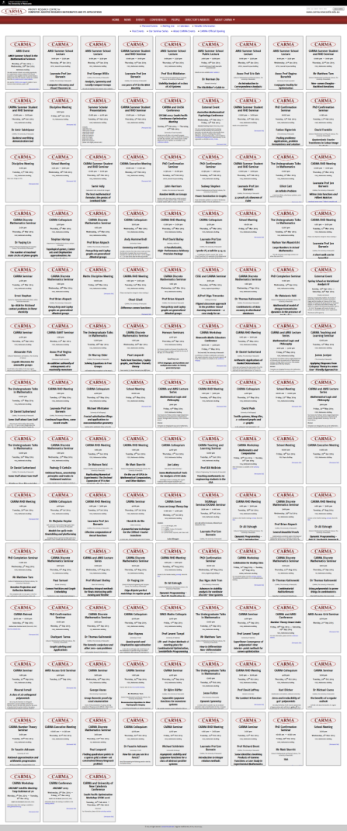
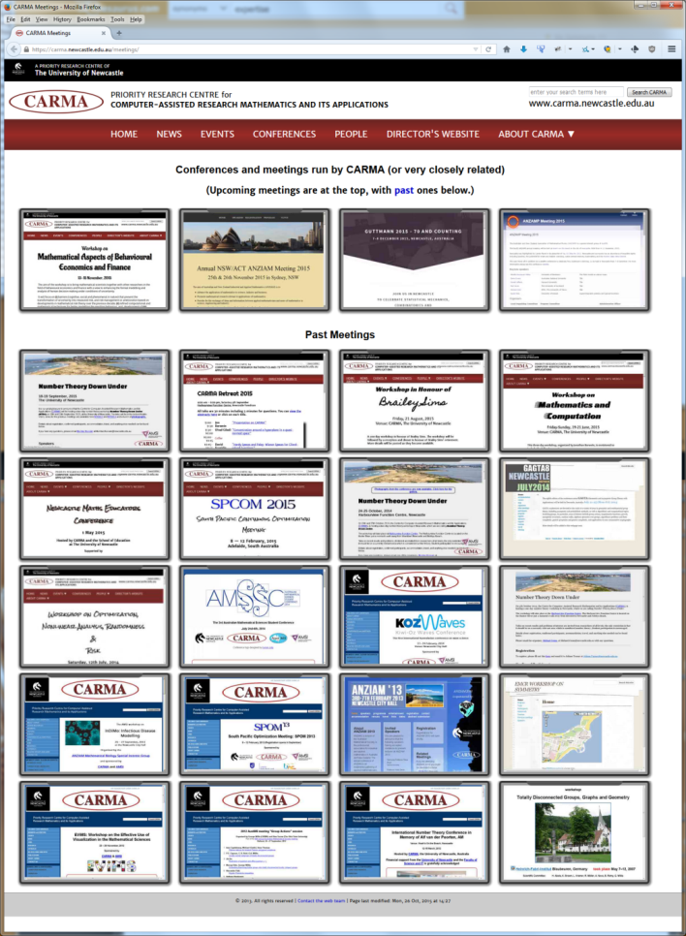
Research
websites
2015
events
Conference
websites

Slide 26
Visualisation
Featured visualisation projects
Walking on Real Numbers
EViMS conferences
NSF Visualisation Challenge
“Complex Beauties” Calendar
Pi Concert, Digital Maitland
Connecting with the modern humanities
Imaging

Slide 27
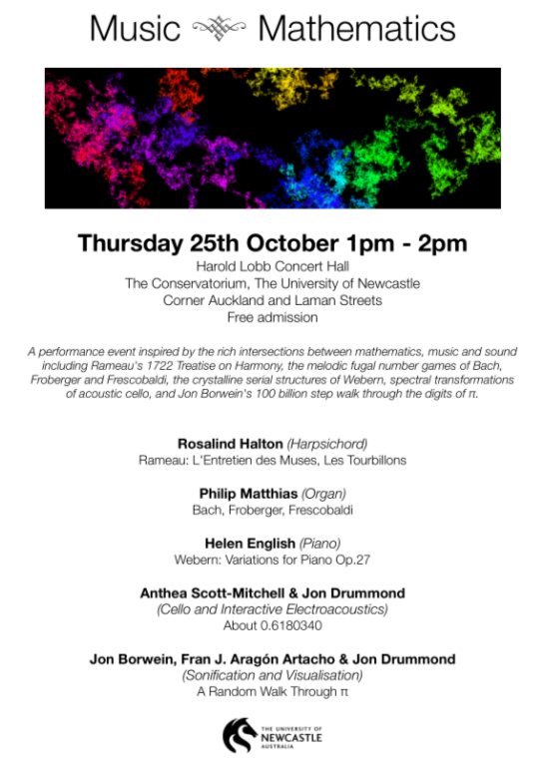
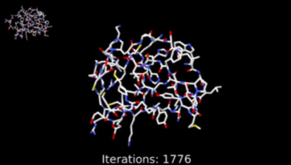
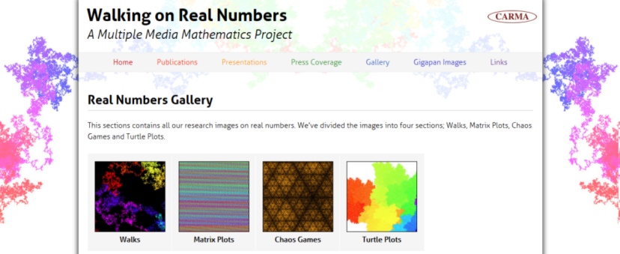
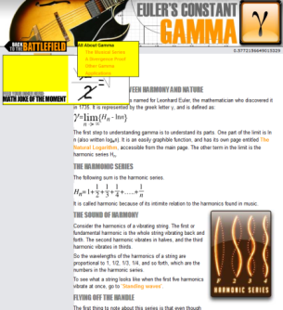
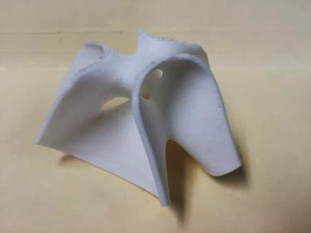
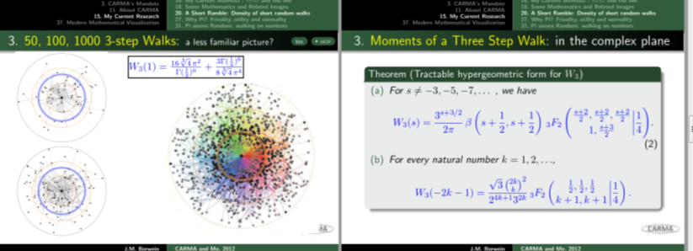
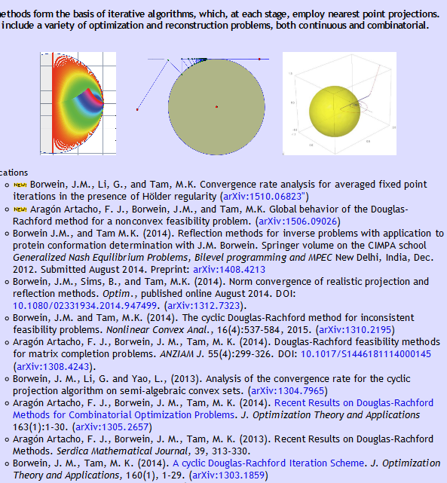
Visualisation

Slide 28
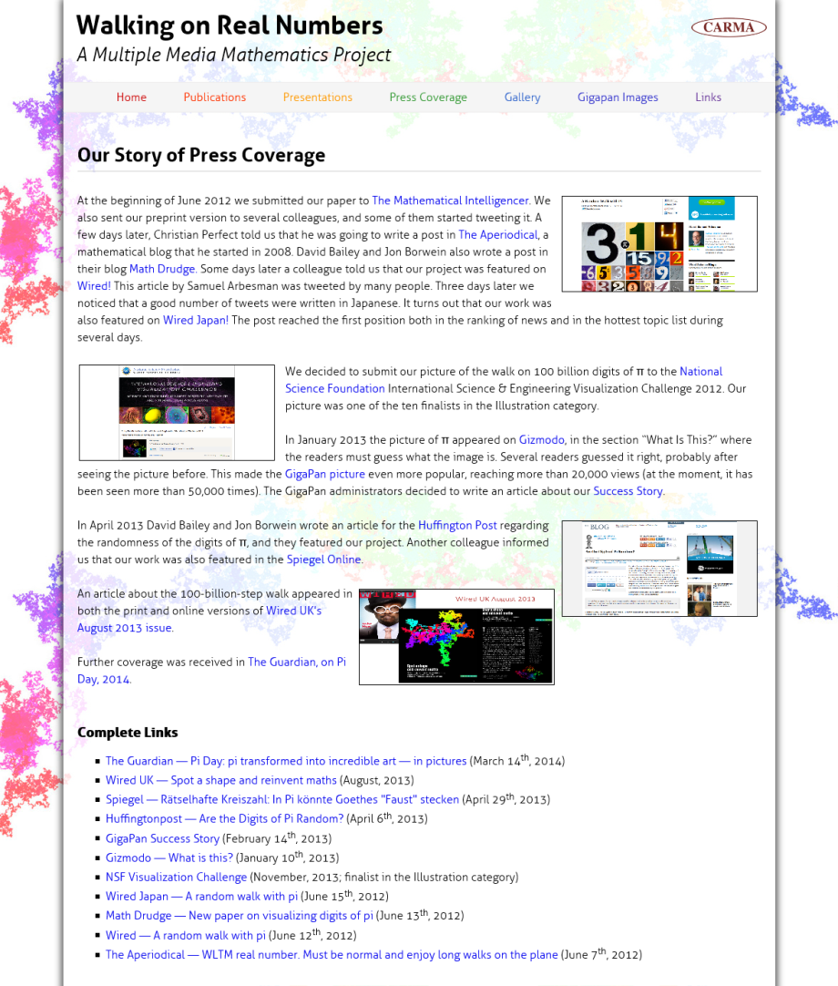
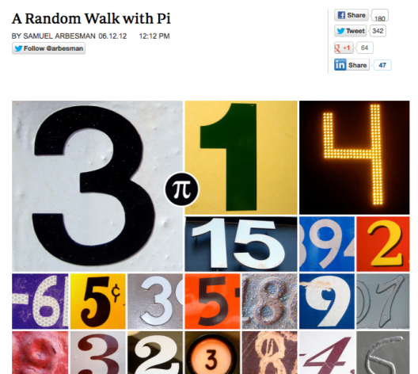
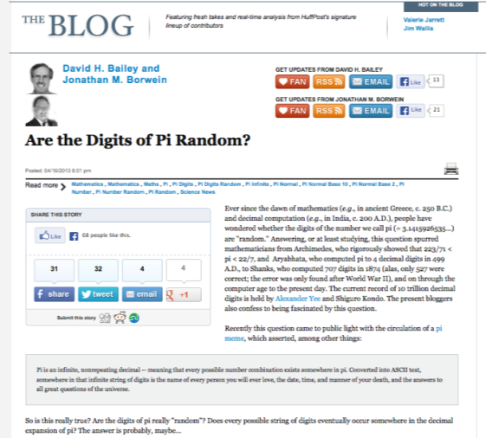

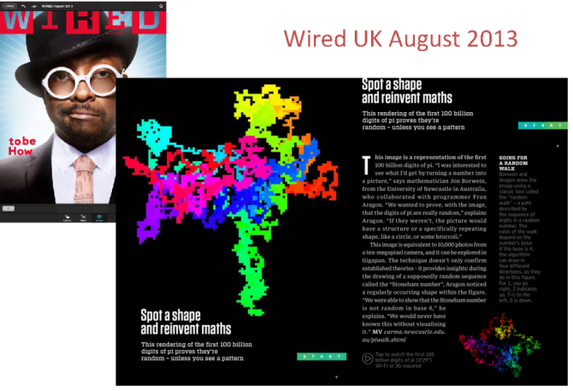
Huffington Post
Wired
NSF Vis Challenge
Wired UK

Slide 29

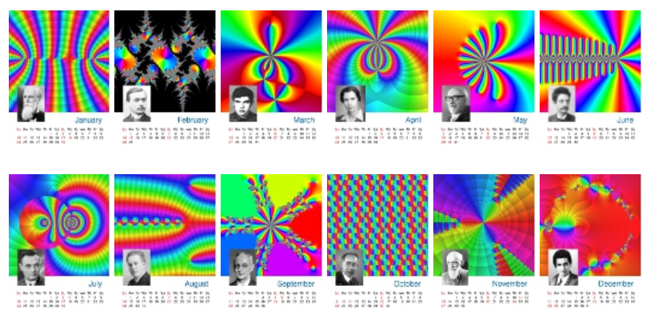

Slide 30
Financial Maths
Financial mathematics at CARMA
MAFFIA: Mathematicians Against Fraudulent Financial and Investment Advice
Interactive on-line financial modelling tools
Backtest Overfitting
“Tenure-maker”
Collaborations with UoN Business School
Mathematical Aspects of Behavioural Economics and Finance co-organised conference
Forthcoming book on reproducible research
Workshop on Optimization, Nonlinear Analysis, Randomness & Risk

Slide 31
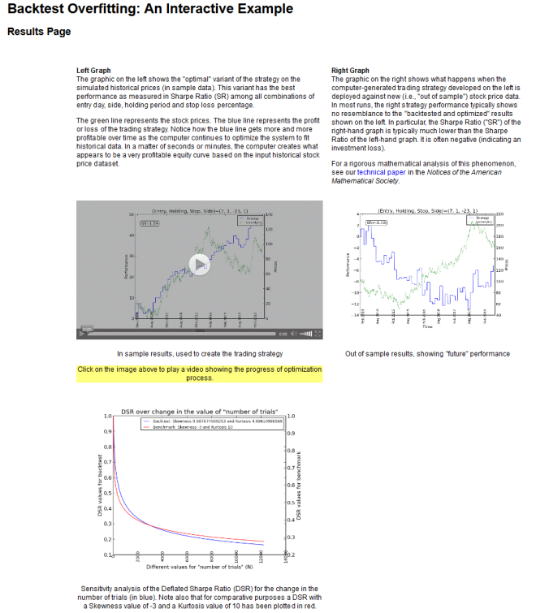
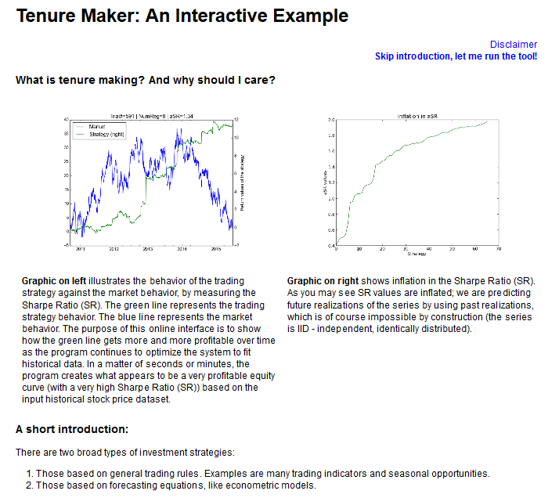
Interactive financial tools

Slide 32
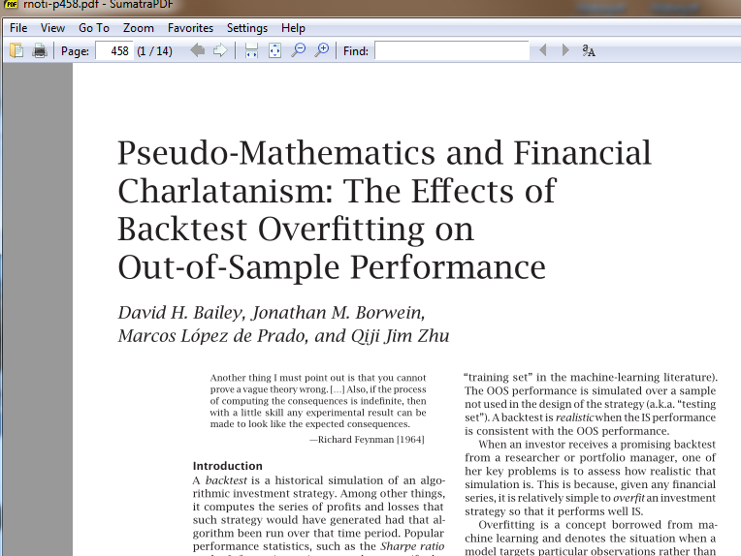
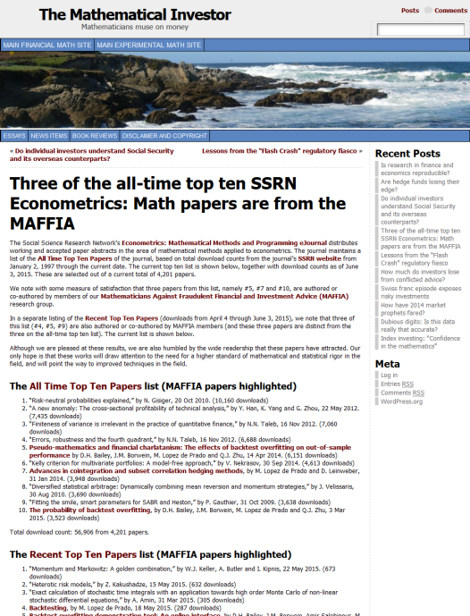
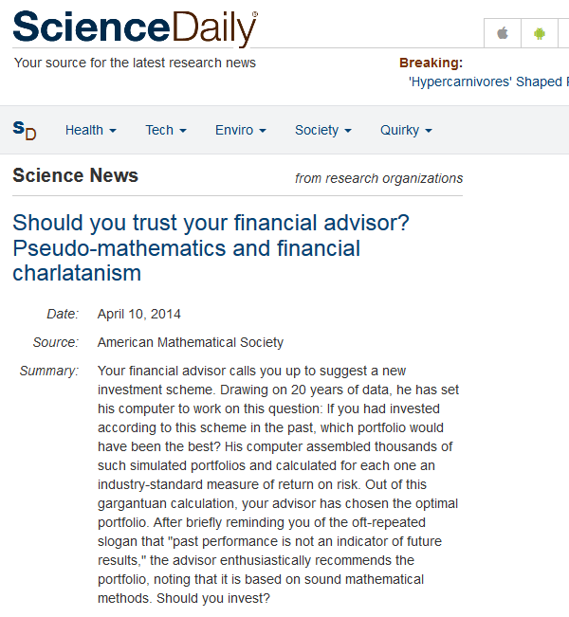
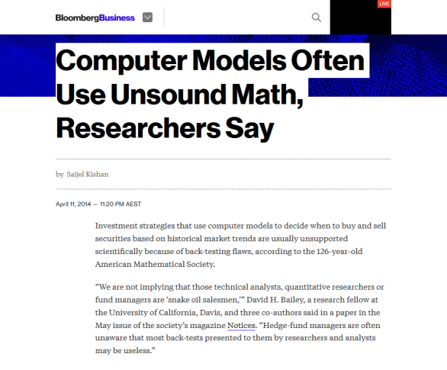


Slide 33
Imaging & Signal Reconstruction
Inverse problems before CARMA
1985- Maximum Entropy Optimization and Signal Reconstruction
1990- Iterative Projection and Reflection Methods
1993-2004 Shared group with Nuclear Medicine and Radiology at Vancouver General Hospital
Functional SPECT for cardiac imaging
Inverse problems at CARMA
2009- Reflection methods for phase reconstruction, protein conformation, ionic liquids (Tam ‘15), …
2009- Fractal models of brain tissue density (Rose ‘15)

Slide 34
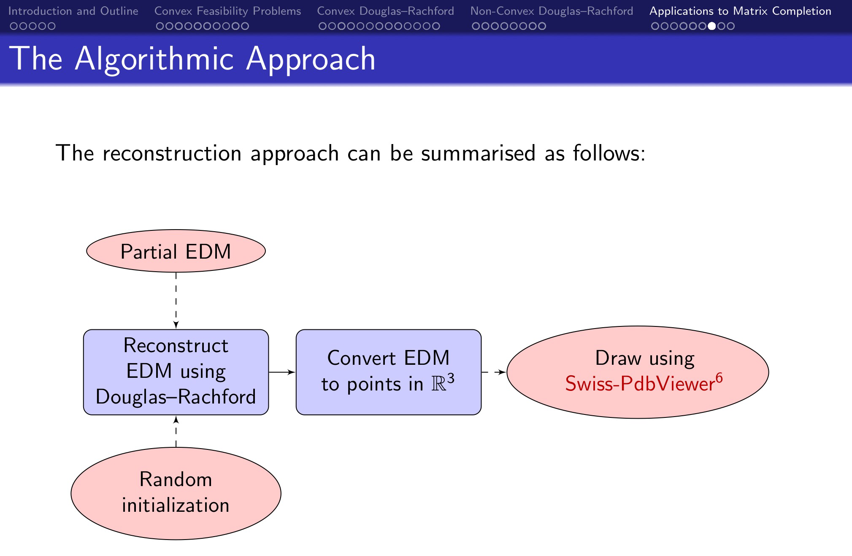
Sex is fun
http://carma.newcastle.edu.au/DRmethods/1PTQ.html
Notes:
protein movie http://carma.newcastle.edu.au/DRmethods/1PTQ.html

Slide 35
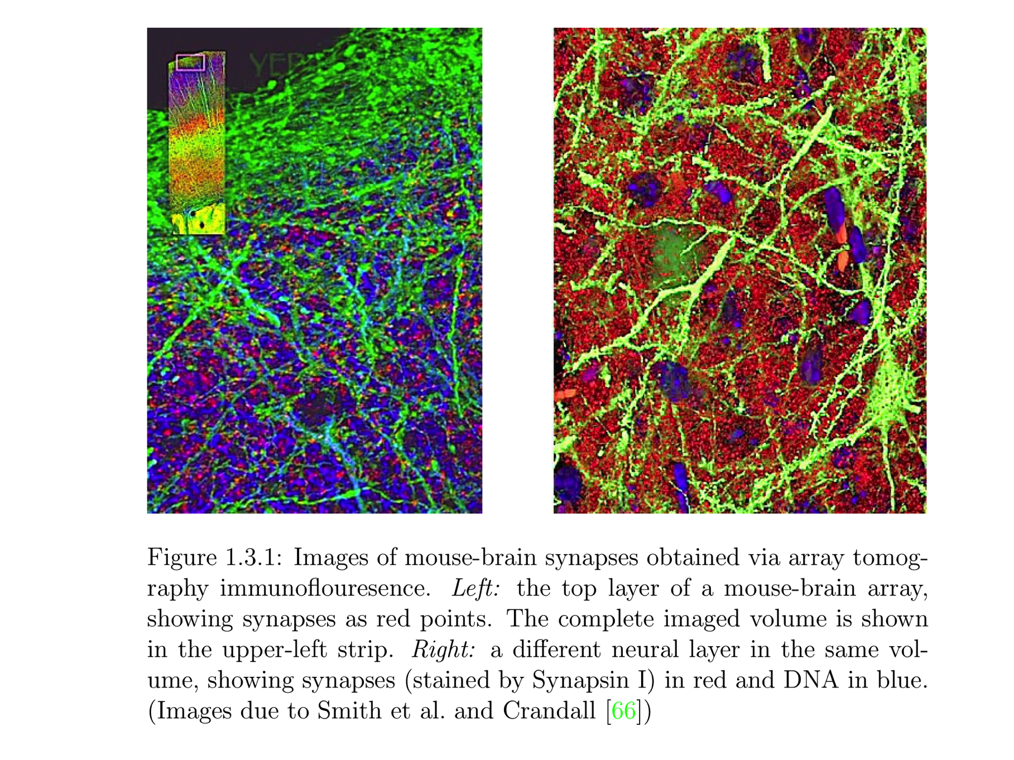
Brain Synapses

Slide 36
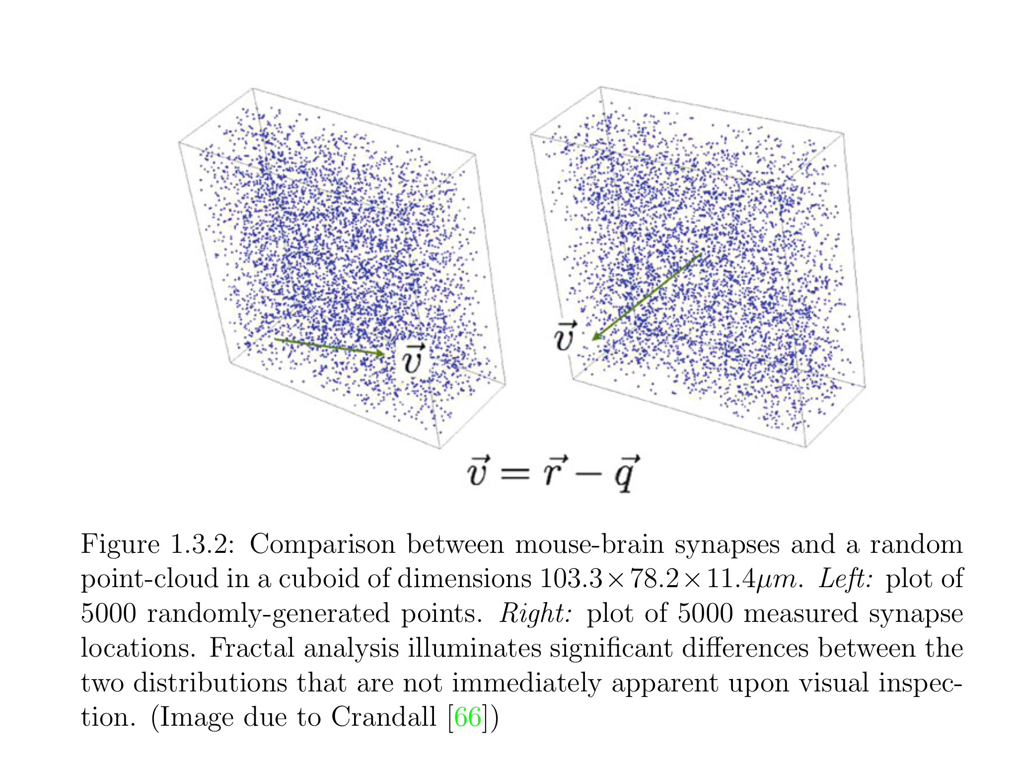
Brain Synapses

Slide 37
CARMA PRC v2016
A strong future
New KPIs to be met:
establish a National Research Centre for Mathematics
in partnership with AMSI, externally funded
host 8 international conferences each year
increase competitive external research funding by 25%
increase PhD student numbers by 50%
publish 25% more papers in leading international journals

Slide 38
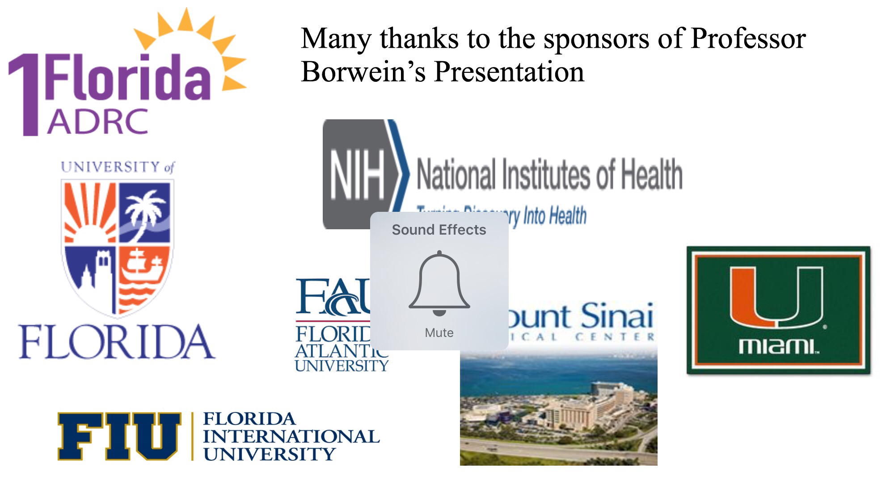
Thanks to all local sponsors

Slide 39
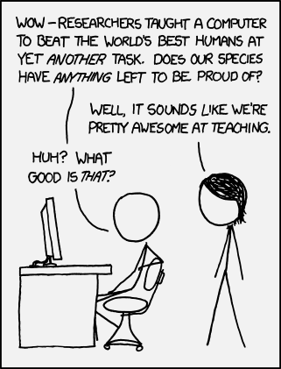
CARMA PRC v2016
Thank you!
Background image: 3D render of random walk visualisation

