Slide 1


Interactions between sound and light on the nanoscale
Christopher G. Poulton
Thursday 26th November, 2015
School of Mathematical and Physical Sciences, University of Technology Sydney (UTS), Australia
TexPoint fonts used in EMF.
Read the TexPoint manual before you delete this box.: AAAAAAA

Slide 2
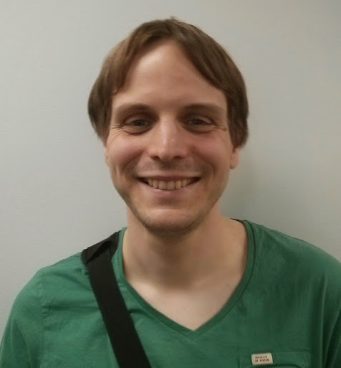


Research team
Christian Wolff
School of Mathematical Sciences, University of Technology Sydney (UTS)
Michael Steel
Department of Physics and Astronomy,
Macquarie University
Mike Smith, David Marpaung, Alvaro Casas-Bedoya and Benjamin J. Eggleton
School of Physics, University of Sydney

Slide 3
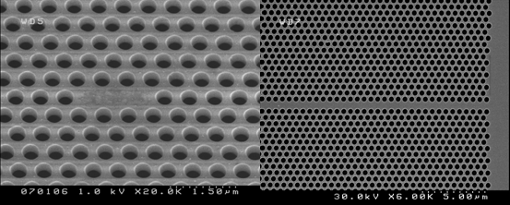
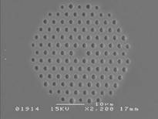
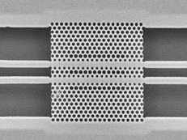
Structured materials in nanophotonics
Photonic crystal waveguide in chalcogenide (CUDOS)
Photonic crystal fibre (Max Planck Erlangen, Germany)
Silicon
air
Photonic crystal coupler-type switch
(Microphotonics group, St Andrews, UK)
Photonic crystal cavity resonator (CUDOS)

Slide 4
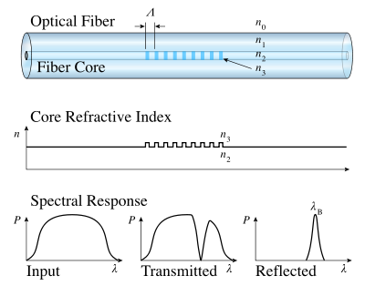
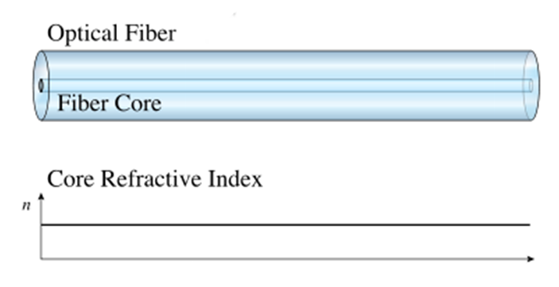
An optical fibre confines light to the region in which it is slowest:
light
A Bragg grating is a one-dimensional periodic modulation of refractive index

Slide 5
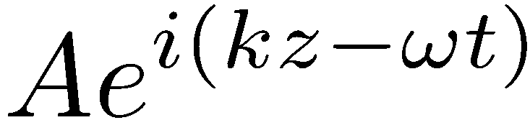
The structure of the grating changes the relationship between energy and momentum of the wave
Photon
(!, k)
!
“normal” relationship:
! = k c
momentum
Optical fibre
energy
Periodic structure relationship:
It’s complicated
k

Slide 6
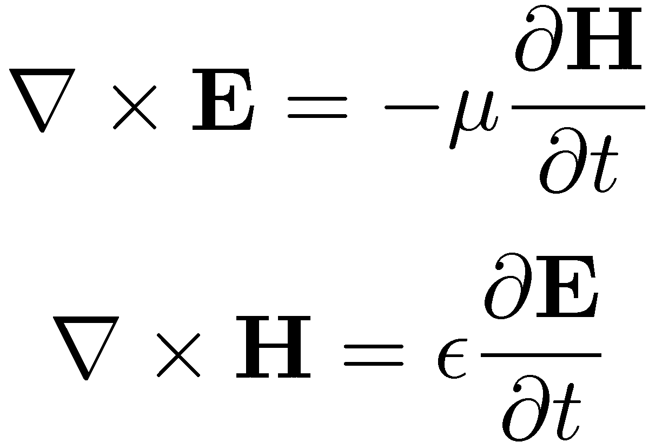
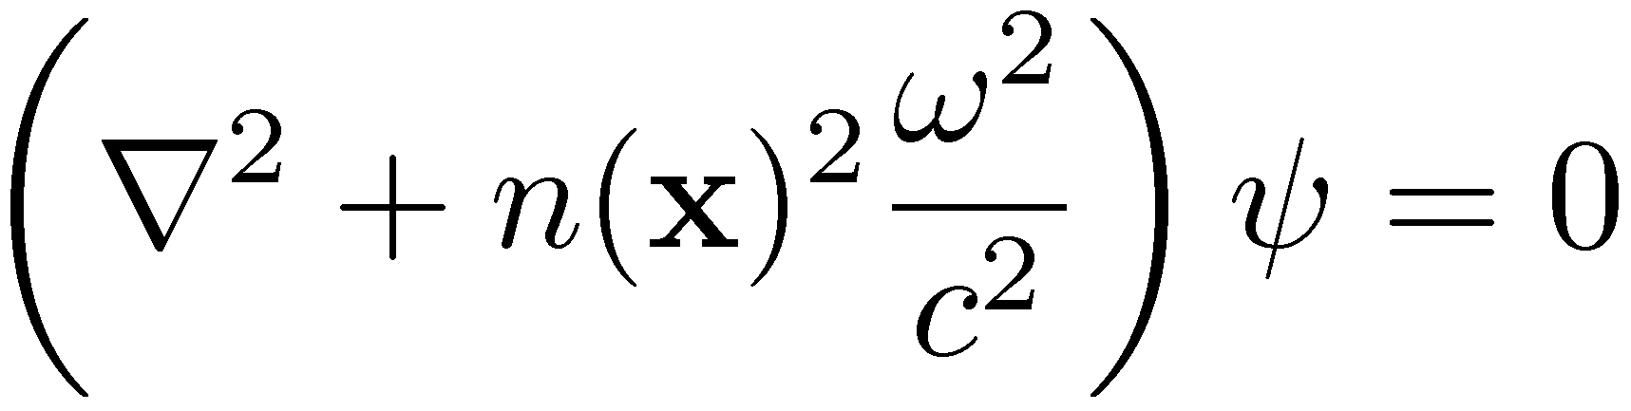
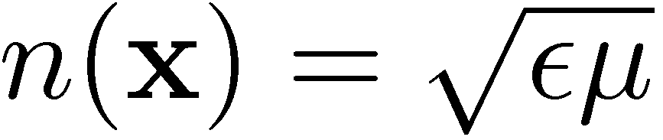
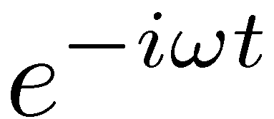
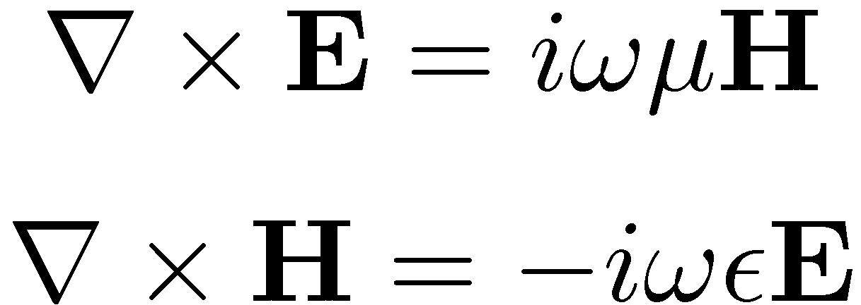
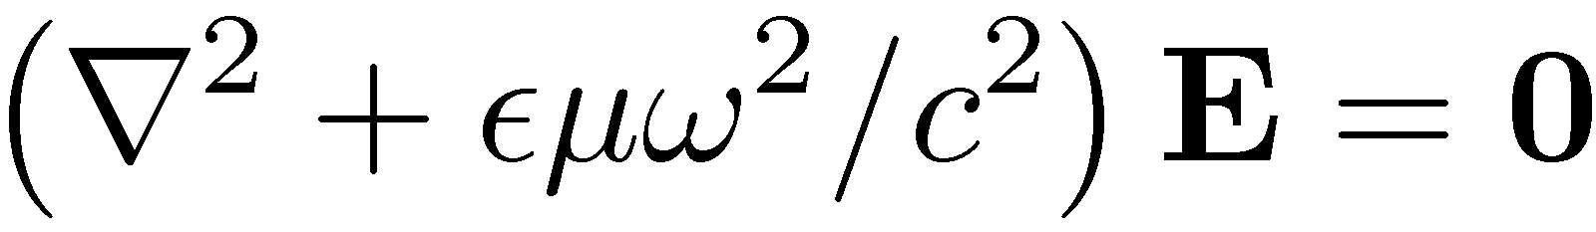
The governing equations for light are Maxwell’s equations:
We have to solve the Helmholtz equation:
Refractive index
Assume all fields vary as

Slide 7
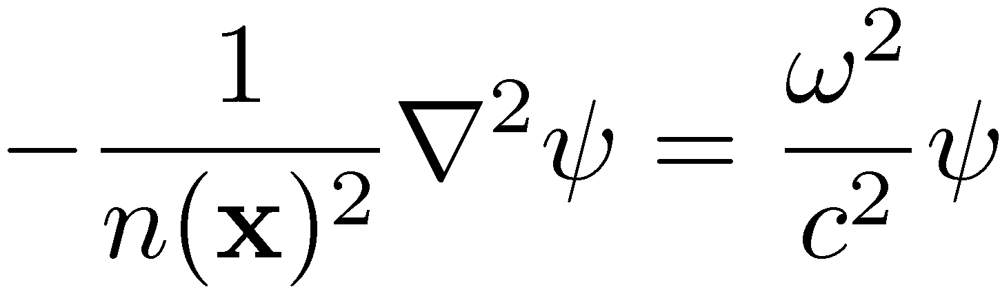
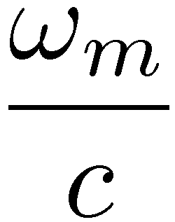
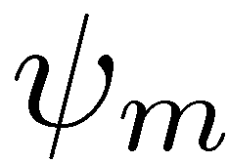
For a finite domain with (say) Ã=0 on the boundary, we obtain a Sturm-Liouville eigenvalue problem:
n(x)
x
Ã₀
Eigenvalues form a discrete set with no upper bound
Eigenfunctions form a complete set
Ã₁
Ã₂

Slide 8
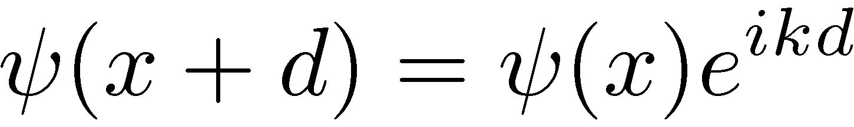
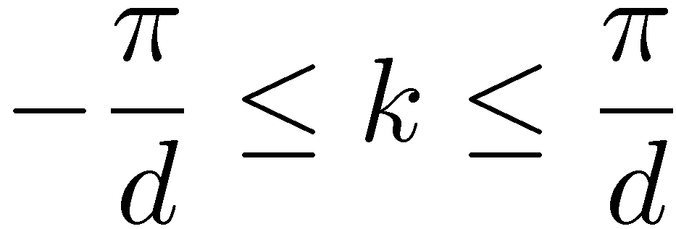
Periodic structures
We now consider the case where n(x) is a periodic function, with periodicity d.
n(x)
n(x)
e^{i k d}
-d
d
2d
3d
d
The Bloch-Floquet theorem:
The quantity k is known as the Bloch wavenumber:

Slide 9
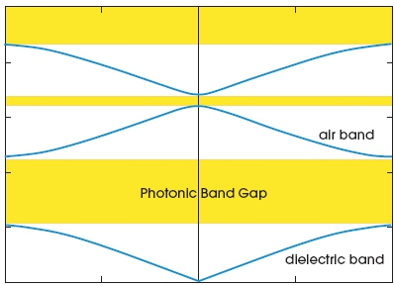
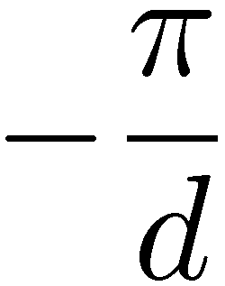
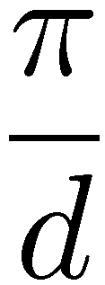
The eigenvalue problem
with boundary conditions
is also a Sturm-Liouville problem, so the solutions form a discrete set for each k.
n(x)
e^{i k d}
d
!
k

Slide 10
!
Within a photonic band gap, there are no real eigenvalues.
What happens if we drive this structure with an incident wave at a frequency within the band gap?
k
Light
frequency
!d /2¼c=0.395

Slide 11

Light

Slide 12
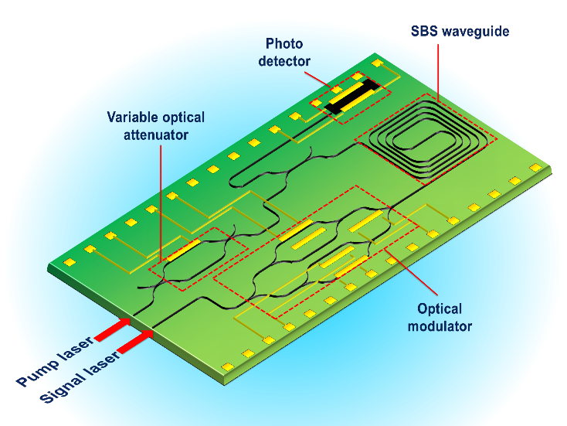
Q: Can we create a nanophotonic circuit where a grating is
turned on or off?
A: we can, via a process called Stimulated Brillouin Scattering

Slide 13
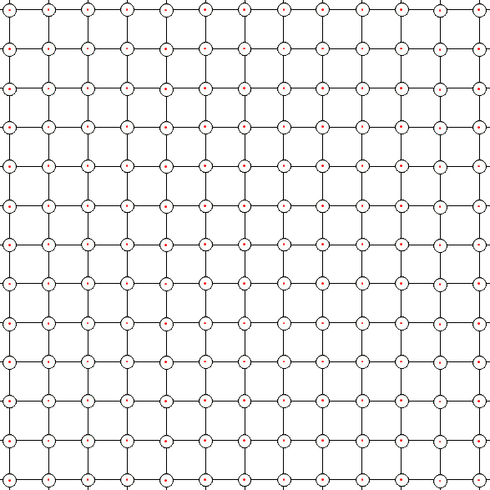
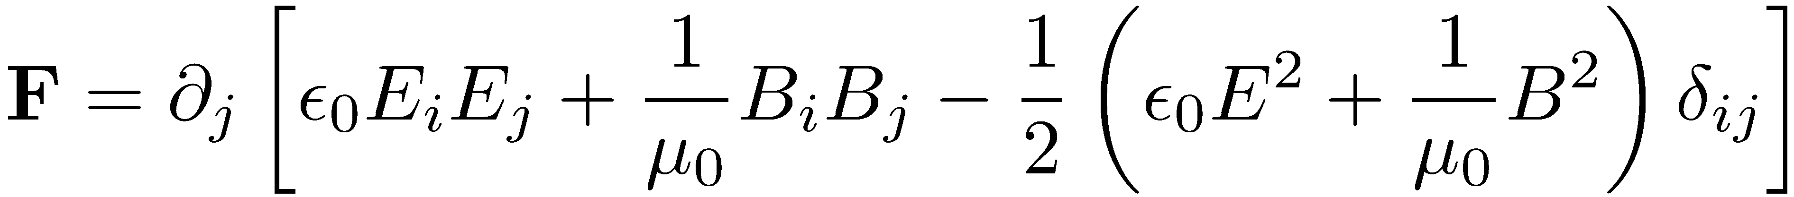
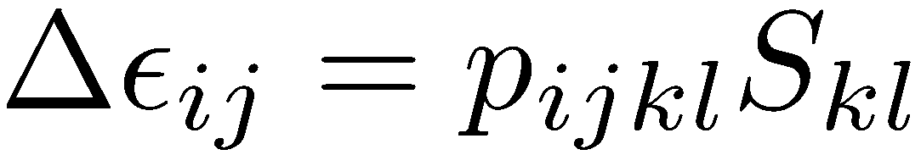
SBS fundamentals
Stimulated Brillouin Scattering
is a coherent interaction between vibrations and electromagnetic waves
The fundamental physical effects of the interaction are:
Optical field
Light
Photoelasticity
(Compressive strain causes
change in refractive index)
Mechanical Deformation
Electrostriction
(Electric field causes material compression)
Atomic lattice

Slide 14


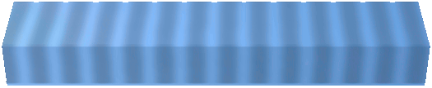



SBS fundamentals
Stimulated Brillouin Scattering (SBS)
The light resonantly excites an acoustic wave in the material.
waveguide
Intensity compresses material
Pump 1 ω₁
Pump 2 ω₂=ω₁
Compression creates index grating
Pump 2 ω₂ = ω₁ − Ω
Pump reflected, down-shifted to ω₂
Excites acoustic wave frequency Ω
Γ_{B}
SBS leads to a narrow Stokes peak in the counter-propagating direction.
Stokes gain
Ω
Brillouin shift
Ω ∼ 2 π x 7-11 GHz
Linewidth
Γ_{B} ∼ 2 π x 15-50 MHz
ω₁
B.J. Eggleton et al., Advances in Optics and Photonics 5 (2013), p536-587.

Slide 15
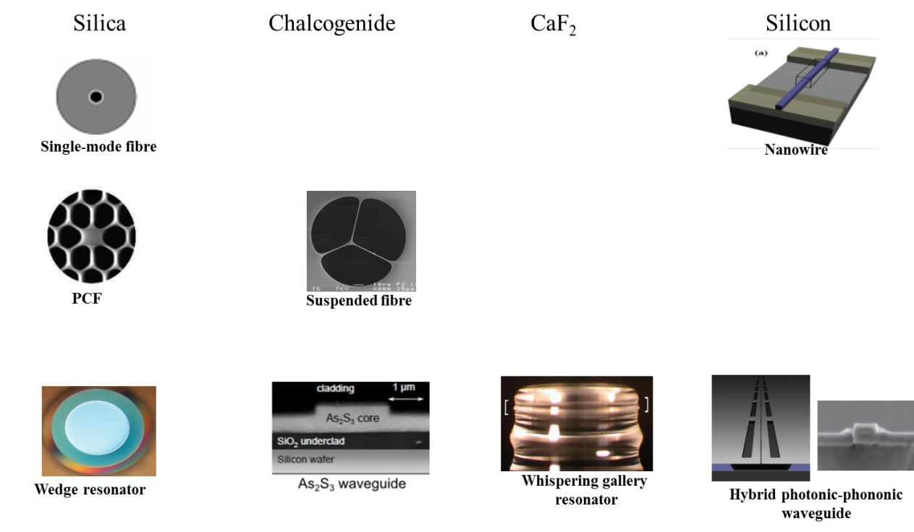
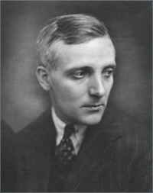
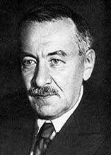
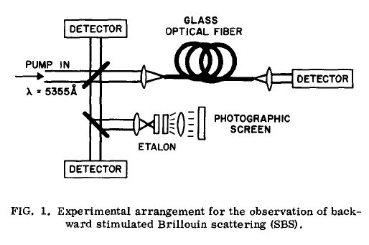
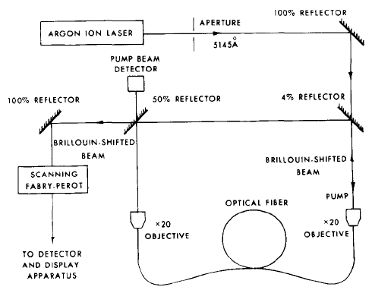
Historical Perspective of SBS
First theoretical predictions^{1,65}
First demonstration of SBS⁶⁹
SBS in liquids⁷⁰⁻⁷²
On-chip SBS⁵¹
SBS in silicon⁵⁵
SBS in gases⁷³
Invention of the laser
1920
1960
1970
1980
2000
2010
Year of discovery
SBS in WGM resonators⁷⁶
SBS in wedge resonators⁵²
First Brillouin laser²
SBS in PCF⁷⁵
SBS in optical fibres⁷⁴
All references from B.J. Eggleton et al., Advances in Optics and Photonics 5 (2013), p536-587

Slide 16
Applications of on-chip SBS
Slow/fast light
On-chip SBS laser
Pant et al. Optics Letters 2011.
Kabakova et al. Optics Letters 2013.
On-chip SBS
Non-reciprocal effects
Tuneable dynamic gratings
Microwave photonic filters
Poulton et al. Optics Express 2012.
Pant et al. Optics Letters 2013
Byrnes et al. Optics Express 2012.

Slide 17
Three big challenges:
Theory
Materials and structures
3. Loss
Optical forces are complicated!
What works for light doesn’t work for sound
Fundamental limitations arise from nonlinear losses

Slide 18



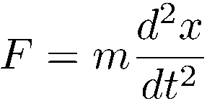

Theory: Solving the acoustic problem
Recall: to solve a mass-on-spring problem, we need:
Newton’s 2nd law
Hooke’s law
force
configuration
material

Slide 19
Key concepts in elasticity:
Stress
Strain
Elastic stiffness
(material)
Describes pressures acting throughout the body
(potential -> force)
Describes the mechanical distortion of a body
(configuration)

Slide 20

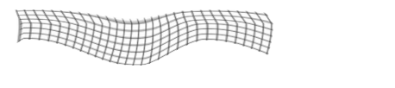
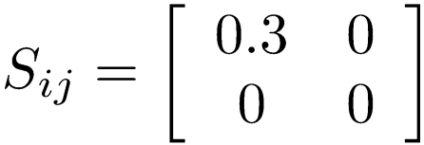
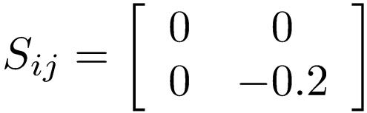
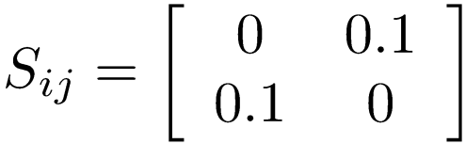
Strain describes the mechanical distortion of a solid body
u
The Iinearised strain comes from the first derivatives of u:
extension in x
compression in y
pure shear
(volume unchanged)
Because it encapsulates the deformation of a box, the strain is a dimensionless second-rank tensor

Slide 21
Stress describes the pressures acting at all points in a solid
z
y
Stress is a second rank tensor that describes the direction of the force, and also the direction of the plane on which it is acting.
x
Positive normal stress T_{xx} > 0
Negative normal stress T_{yy} < 0
Positive shear stress T_{xy} > 0

Slide 22
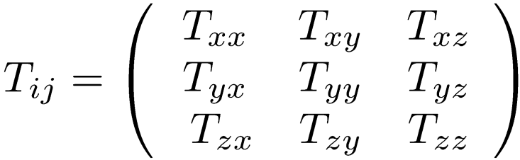
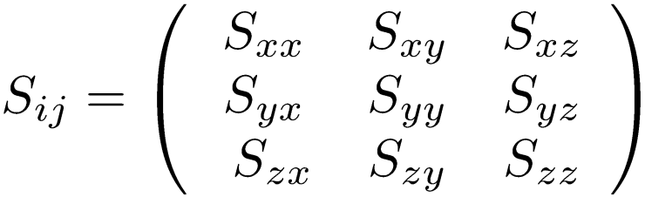


Hooke’s law
Stress
Strain
Hooke’s law states that stress and strain are linearly related.
The constitutive relationship involves a fourth-rank tensor
(unlike in EM theory, where it is rank 2)

Slide 23
The main stiffness properties of isotropic materials are:
Young’s modulus E
How hard it is to stretch
The bulk modulus K
How hard it is to compress
Units of Pa
The shear modulus ¹
How hard it is to shear
Lame’s first parameter ¸
No real meaning
The Poisson ratio º
extension in y
(dimensionless)
compression in x
Any two of these completely specify the stiffness tensor.

Slide 24
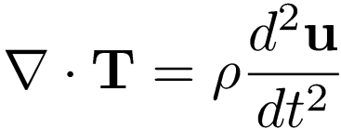

Newton’s second law for continuous bodies
Consider a small volume element with displacement u from equilibrium:
Displacement of volume element
Force per unit volume
density
Together with Hooke’s law
and boundary conditions, we can solve for any elastic problem.
Continuity of displacement, normal components of stress

Slide 25
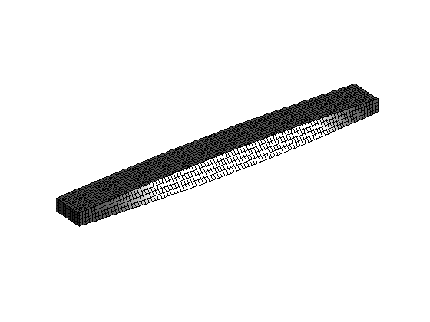
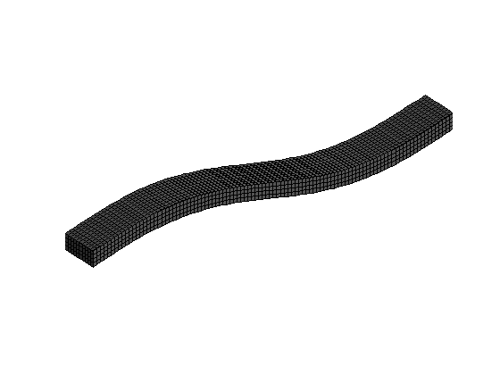
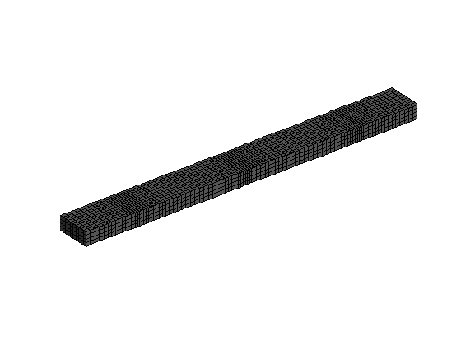
Types of solutions:
Bending modes
Twisting modes
Pressure modes

Slide 26
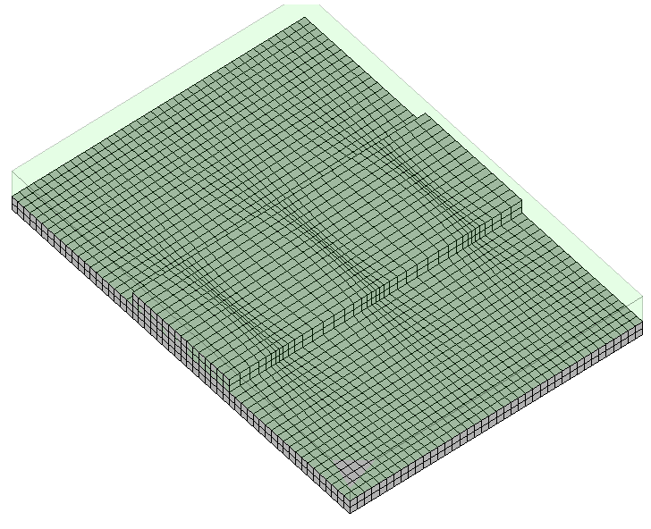
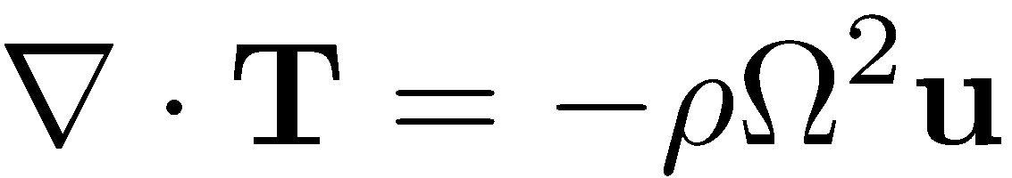
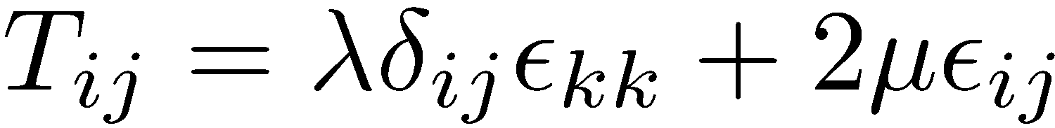
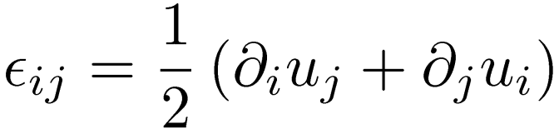
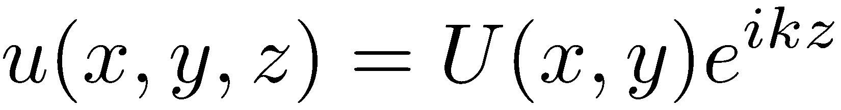
Acoustic waves in nanophotonic waveguides
Restate Newton’s 2nd law:
displacement
Acoustic mode
y
Stress tensor
x
Substitute Hooke’s law:
z
where the strain is
Eigenvalue problem for Ω, u
strain tensor
and assume that the field u is harmonic in z:
½: density
(¸, ¹): Lamé parameters

Slide 27
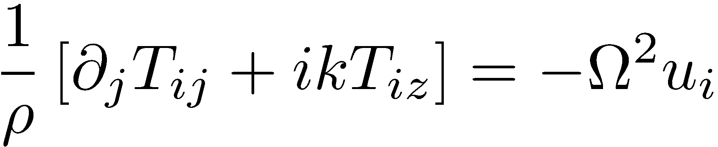
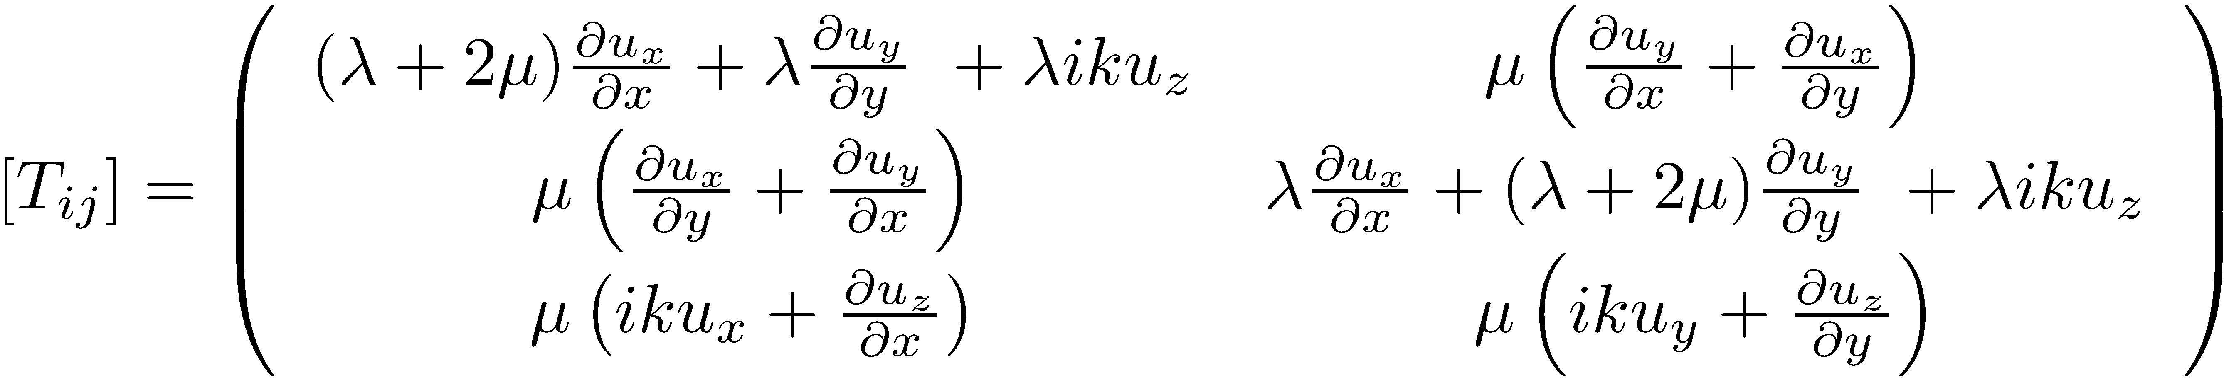
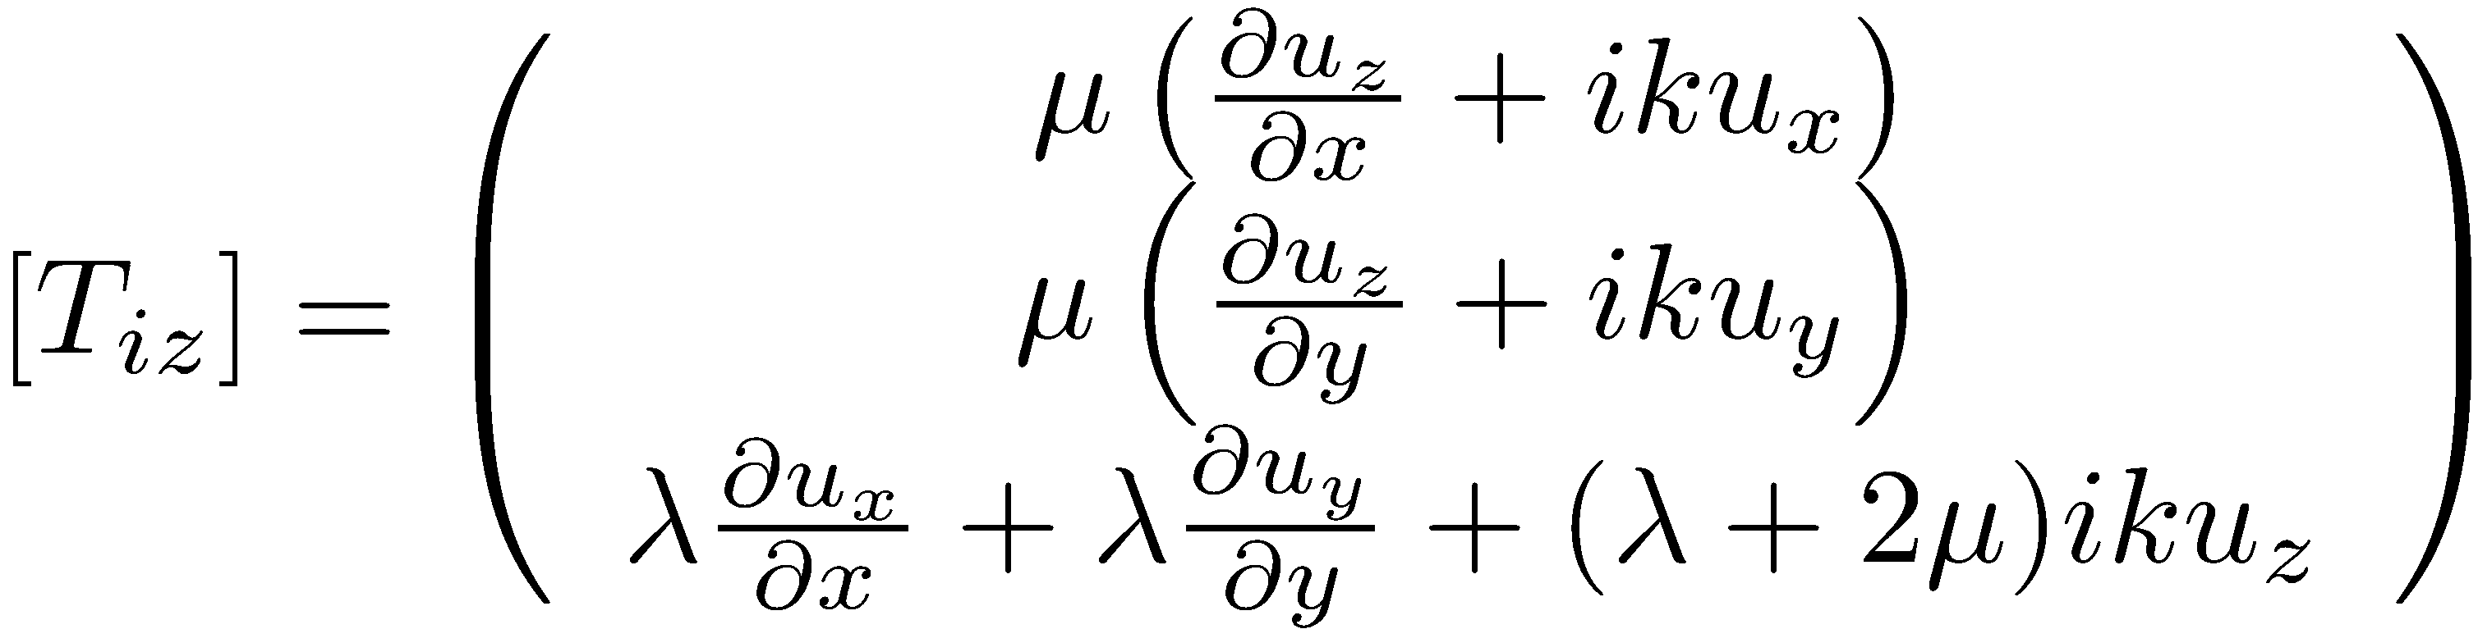

We obtain the eigenvalue problem for Ω:
where
y
x
z
and
Together with the boundary conditions

Slide 28





Types of waves
Flexural Mostly shear
Torsional Mostly Shear
Wave speed
Longitudinal
Mostly longitudinal

Slide 29


Coupling between optical and acoustic modes
Expand in mode fields:
Optical fields
Accoustic fields
Substitute into the appropriate PDEs
Assume 1) Slow-varying of amplitudes a and b, 2) coupling is locally weak and
3) acoustic waves are much slower than optical waves
With coupling terms:

Slide 30







Theory of SBS: original formulation
Original theory:
waveguide
Optical fields
Acoustic field
The coupling terms involve optical forces:
E₁
However: optical forces in materials (and at boundaries) are complicated!
E₂
Resulting boundary force
Electric fields
Barnett, S. M., & Loudon, R. Phil. Trans. Roy. Soc. Lond. A 368, 927-939 (2010).

Slide 31


Theory of SBS: new formulation
New theory:
Optical fields
waveguide
Acoustic field
The coupling terms involve conserved field quantities on the boundaries:
Equating these two formulation we show that each scattering process has a corresponding optical force

Slide 32

Results (acoustic modes):
4 ¹m
140 nm SiO₂ coating
As₂S₃
SiO₂
Computed (longitudinal) mode of a As₂S₃ rib waveguide. Shading indicates the change in the material density, which determines the magnitude of Brillouin gain via electrostriction.
Results (optical modes):

Slide 33



Result: Calculated Brillouin gain spectrum for a coated rib waveguide:
Incident light
Reflected light

Slide 34
Applications of on-chip SBS
Slow/fast light
On-chip SBS laser
Pant et al. Optics Letters 2011.
Kabakova et al. Optics Letters 2013.
On-chip SBS
Non-reciprocal effects
Tuneable dynamic gratings
Microwave photonic filters
Poulton et al. Optics Express 2012.
Pant et al. Optics Letters 2013
Byrnes et al. Optics Express 2012.

Slide 35
Slow-light on a chip
We can use Brillouin scattering to introduce a gain resonance in the counter-propagating direction:
Counter- propagating light
Pump
Due to causality, this gain must be accompanied by a change in the refractive index
_{g(ω)}
_{n(ω)}
_{n(ω)}
_{ω}
!_{s}
!_{P}
!_{as}
_{-g(ω)}

Slide 36


_{g(ω)}
_{n(ω)}
_{n(ω)}
_{ω}
!_{s}
!_{P}
!_{as}
_{-g(ω)}
Velocity of a pulse:
Where n_{g} is the group index:
Large change in refractive index
Strongly modified pulse velocities

Slide 37


Schematic of experiment:
Input probe !_{s}
Pump on
Pump off
Laser 1
t
t
Pump !_{P}
Laser 2

Slide 38

Actual experiment:

Slide 39

Results: slowing of optical pulses
Increasing power

Slide 40

Increasing power

Slide 41


Phase measurements of group index:
_{g(ω)}
_{n(ω)}
_{n(ω)}
_{ω}
!_{s}
!_{P}
!_{as}
_{-g(ω)}
Slow light
Fast light
“Backward light”

Slide 42




Slide 43
Outlook
Future directions and open questions:
Is SBS feasible in CMOS-compatible materials?
The effect of 2D and 3D structure
Can we create an opto-acoustic “supermaterial”?

Slide 46






On-chip slow and fast light
Slow-light on a chip
Due to causality, this gain must be accompanied by a change in the refractive index
_{g(ω)}
_{n(ω)}
_{n(ω)}
_{ω}
!_{s}
!_{P}
!_{as}
Counter- propagating light
_{-g(ω)}
Pump
Increasing power
Demonstration of slow-light on a chip:
Max Delay = 22 ns
Max Advancement = 7 ns
Pant et al. Optics letters 37.5 (2012): 969-971.

Slide 47
Challenges in SBS
The grand vision: on-chip SBS in CMOS-compatible materials
However there are three big challenges:
Theory
Materials and structures
3. Loss
Optical forces are complicated!
What works for light doesn’t work for sound
Fundamental limitations arise from nonlinear losses

Slide 48

Theory of SBS: new formulation
Theory: Modelling of the interaction can be done via coupled mode equations
waveguide
Optical fields
Acoustic field
The coupling terms involve optical forces:
e₁
However: optical forces in materials (and at boundaries) are complicated!
e₂
Resulting boundary force
Electric fields
Barnett, S. M., & Loudon, R. Phil. Trans. Roy. Soc. Lond. A 368, 927-939 (2010).

Slide 49
Theory of SBS: new formulation
Solution: avoid forces altogether.
From perturbation theory of Maxwell’s equations:
For reversible interactions it can be shown that
i.e. each scattering process has a corresponding optical force
Light
Electrostriction
Radiation pressure
Photoelasticity
Mechanical Deformation
Motion of boundaries
C. Wolff et al. Stimulated Brillouin scattering in integrated photonic waveguides, accepted in Phys. Rev A, June 2015

Slide 50



Acoustic confinement
The acoustic field must be confined to the core
For pressure waves, the governing equation is
Ω = v₂ q
Frequency Ω
TIR region
Acoustic field (relative density change)
Sound velocity
The inverse sound velocity plays the role of acoustic refractive index
Ω = v₁ q
Propagation constant q
Confinement possible from Total Internal Reflection
if v_{core} < v_{cladding}.
i.e. the core must be less stiff than the cladding or substrate

Slide 51
Material requirements for guided SBS
Material requirements for SBS in waveguides:
Non-negligible photoelastic coefficients in core
High refractive index in core
Both acoustic and optical modes must be confined
The core must have a higher refractive index than the substrate, but be less stiff
What can work: Chalcogenides on silica
What won’t work:
Silicon on silica (acoustic field lost to substrate)

Slide 52


A new challenge: nonlinear loss
Two-photon absorption excites carriers (2PA)
Carriers induce optical loss (FCA)
2ω
Excited carriers
Valence band
2PA leads to minimal direct loss, scales as I ²
FCA leads to large losses due to narrow linewidth of SBS, scales as I ³
FCA puts fundamental limits on the absolute gain
gain parameter
FOM:
2PA coefficient
FCA coefficient
Linear loss
FOM for Silicon nanobeam@1550nm: ~ 1.4
Wolff et al., accepted JOSA B, July 2015
Maximal Stokes amplification: ~ 6dB

Slide 53




New material systems
Proposal: Germanium in Silicon Nitride
Soref, R. Nature Photonics, 4(8), 495–497 (2010) .
High Gain in the mid IR (4 um).
NB: anisotropy leads to large differences in gain
Wolff, C., et al. Optics Express 22, p30735 (2014).

Slide 54


New directions: metamaterials
Metamaterials can be used to enhance or suppress electrostriction
Natural log of electrostriction enhancement for silver spheres in a chalcogenide matrix
The idea: dipole resonances between embedded
spheres enhance the interactions
Factor of 3.7 enhancement in electrostrictive constant
M. Smith et al., Phys. Rev. B 91, 214102 (2015).

Slide 55
Conclusions
Conclusions
Optical forces can be avoided in the theory
Acoustic guidance is critical, and what works for light does not always work for sound
Nonlinear losses put critical limits on the applicability of SBS (silicon is particularly affected).
FOM:
Strong potential to engineer new materials for high SBS gain.
Funding Sources
ARC Discovery Project (DP130100382)
CUDOS ARC Centre of Excellence (CE110001018)
ARC Laureate Fellowship (Prof. B.J. Eggleton, FL120100029)

Slide 57
Historical Perspective of SBS
First theoretical predictions^{1,65}
First demonstration of SBS⁶⁹
SBS in liquids⁷⁰⁻⁷²
On-chip SBS⁵¹
SBS in silicon⁵⁵
SBS in gases⁷³
Invention of the laser
1920
1960
1970
1980
2000
2010
Year of discovery
SBS in WGM resonators⁷⁶
SBS in wedge resonators⁵²
First Brillouin laser²
SBS in PCF⁷⁵
SBS in optical fibres⁷⁴
All references from B.J. Eggleton et al., Advances in Optics and Photonics 5 (2013), p536-587

Slide 58


Selection rules
The coupling between acoustic and optical modes is governed by simple selection rules
group C_{6v}
C. Wolff, M.J. Steel, and C.G. Poulton. Optics Express 22, 32489-32501 (2014).

