Slide 1



Welcome to the 4th annual CARMA Retreat
Harbourview Room
Harbourview Function Centre
9.00-5.30
August 30th 2014
http://carma.newcastle.edu.au/jon/vc-visit13.pdf

Slide 2

AM Agenda
8.30am Registration, Coffee & Light Breakfast
9:00 – 9.30 Welcome and General Overview – JMB
Research at CARMA
9.30 – 10.30 Mike Meylan and Michael Coons
10.30 – 11.00 Morning Tea
Academic Liaising
11.00 – 11.30 Ljilijana Brankovic
Education/Outreach Activities
11.30 – 12.30 Judy-anne Osborn and Elena Prieto-Rodriguez
12.30 – 2.00 Lunch

Slide 3
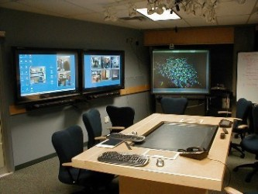
Welcome and Overview
Introductions About CARMA
past
present
future
The rest of the day

Slide 4
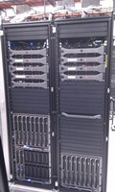
UPDATED VITAL STATISTICS
Members: 59 total 34 regular/exec 3 external committee 8 students 10 external 4 other Our computing facilities: 12 MacPros (approx 216 cores OSX and Linux) 2 Linux servers (approx 32 cores total) Central computing grid of 1024 cores
(768 cores general access,256 for FSCIT)
Access Grid classes 2014: 500 hrs (equiv. 12 months) V205/6 seminars, RHD meetings, etc: 130 hrs (12 months) All seminars : approx 180 hrs (last 12 months)

Slide 5

PM Agenda
Future of Research at the University
2.00 – 2.30 George Willis
Future Planning for CARMA
2.30 – 3.30 JMB and Gerard Joseph (Discussion)
3.30 – 4.00 Afternoon Tea
Talks by Members
4.00 – 4.20 Ali Eshragh
4.20 – 4.40 Thomas Kalinowski
4.40 – 5.00 Nagmana Hussain
5.00 – 5.20 Murray Elder
6.00 Dinner (Sticky Rice)
Cnr Scott & Zaara St (02) 4927 0200

