Slide 1
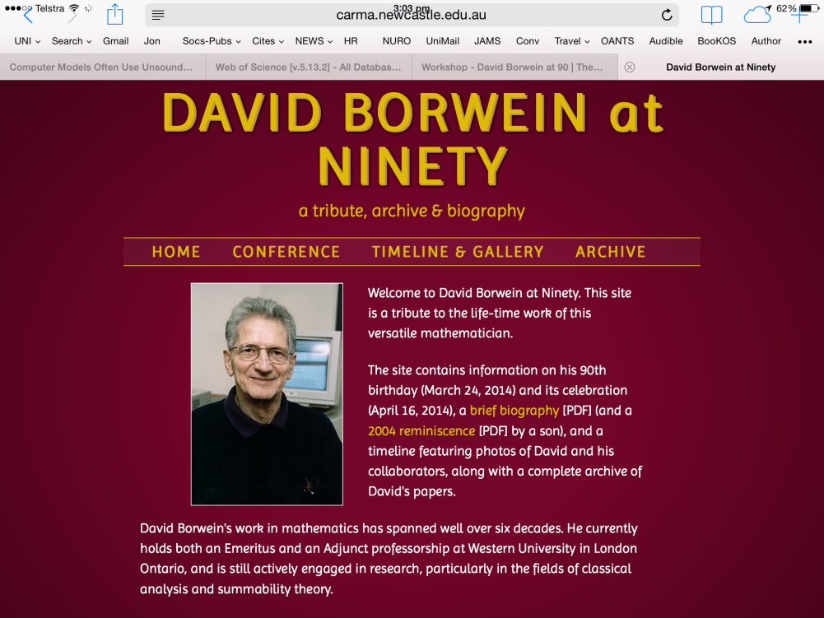
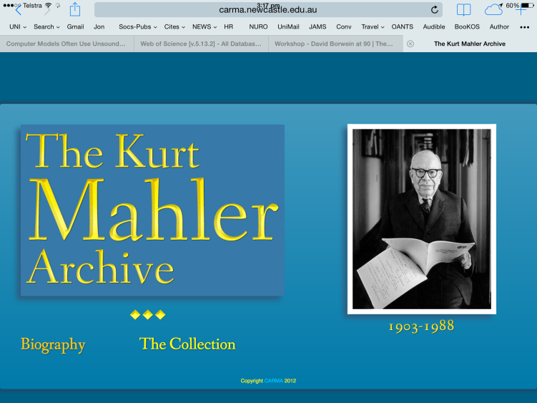
The David Borwein Archive
What it contains
Archive of all DB papers in PDF
A brief CV
A timeline with papers, many photos and a few movies
Documentation on 80th Birthday meeting run at the CMS in Halifax
A modern tribute
carma.newcastle.edu.au/db90/
Modelled on Mahler Archive (2012) carma.newcastle.edu.au/mahler/
IP issues
  there is little market left for collected works in print
  “open access” is becoming a reality
Persistence issues
Let us open the archive

